Slide 1
The College of Dental Surgeons of Saskatchewan
Board of Directors
Meeting
Presented by:
Dr. Heather Carr
CDA President
March 25, 2024

Slide 2
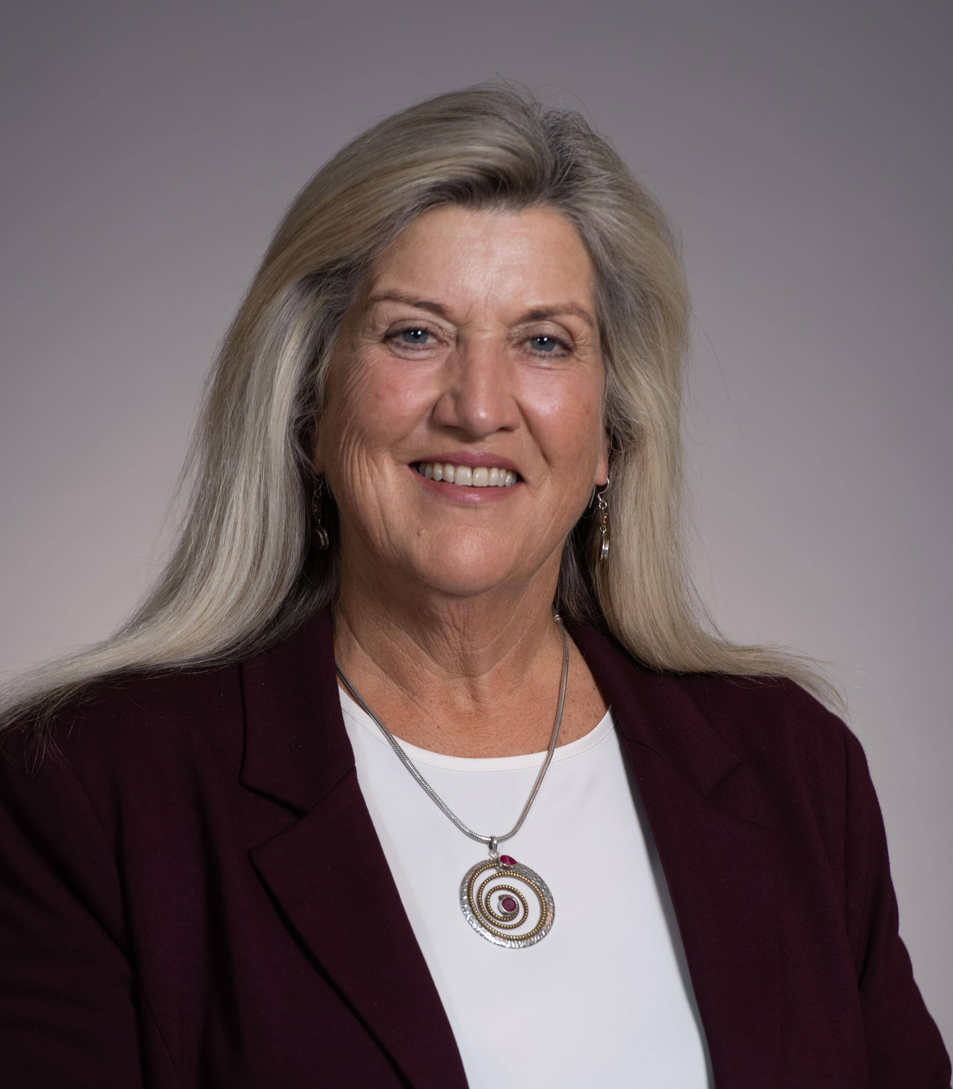
Dr. Heather Carr
CDA President 2023 – 2024
Serving on CDA board since 2015
Past President DDSS, NSDA & Halifax County Dental Society
DDS Dalhousie University- 1988
35 years in general practice
Lifelong local community contributor

Slide 3
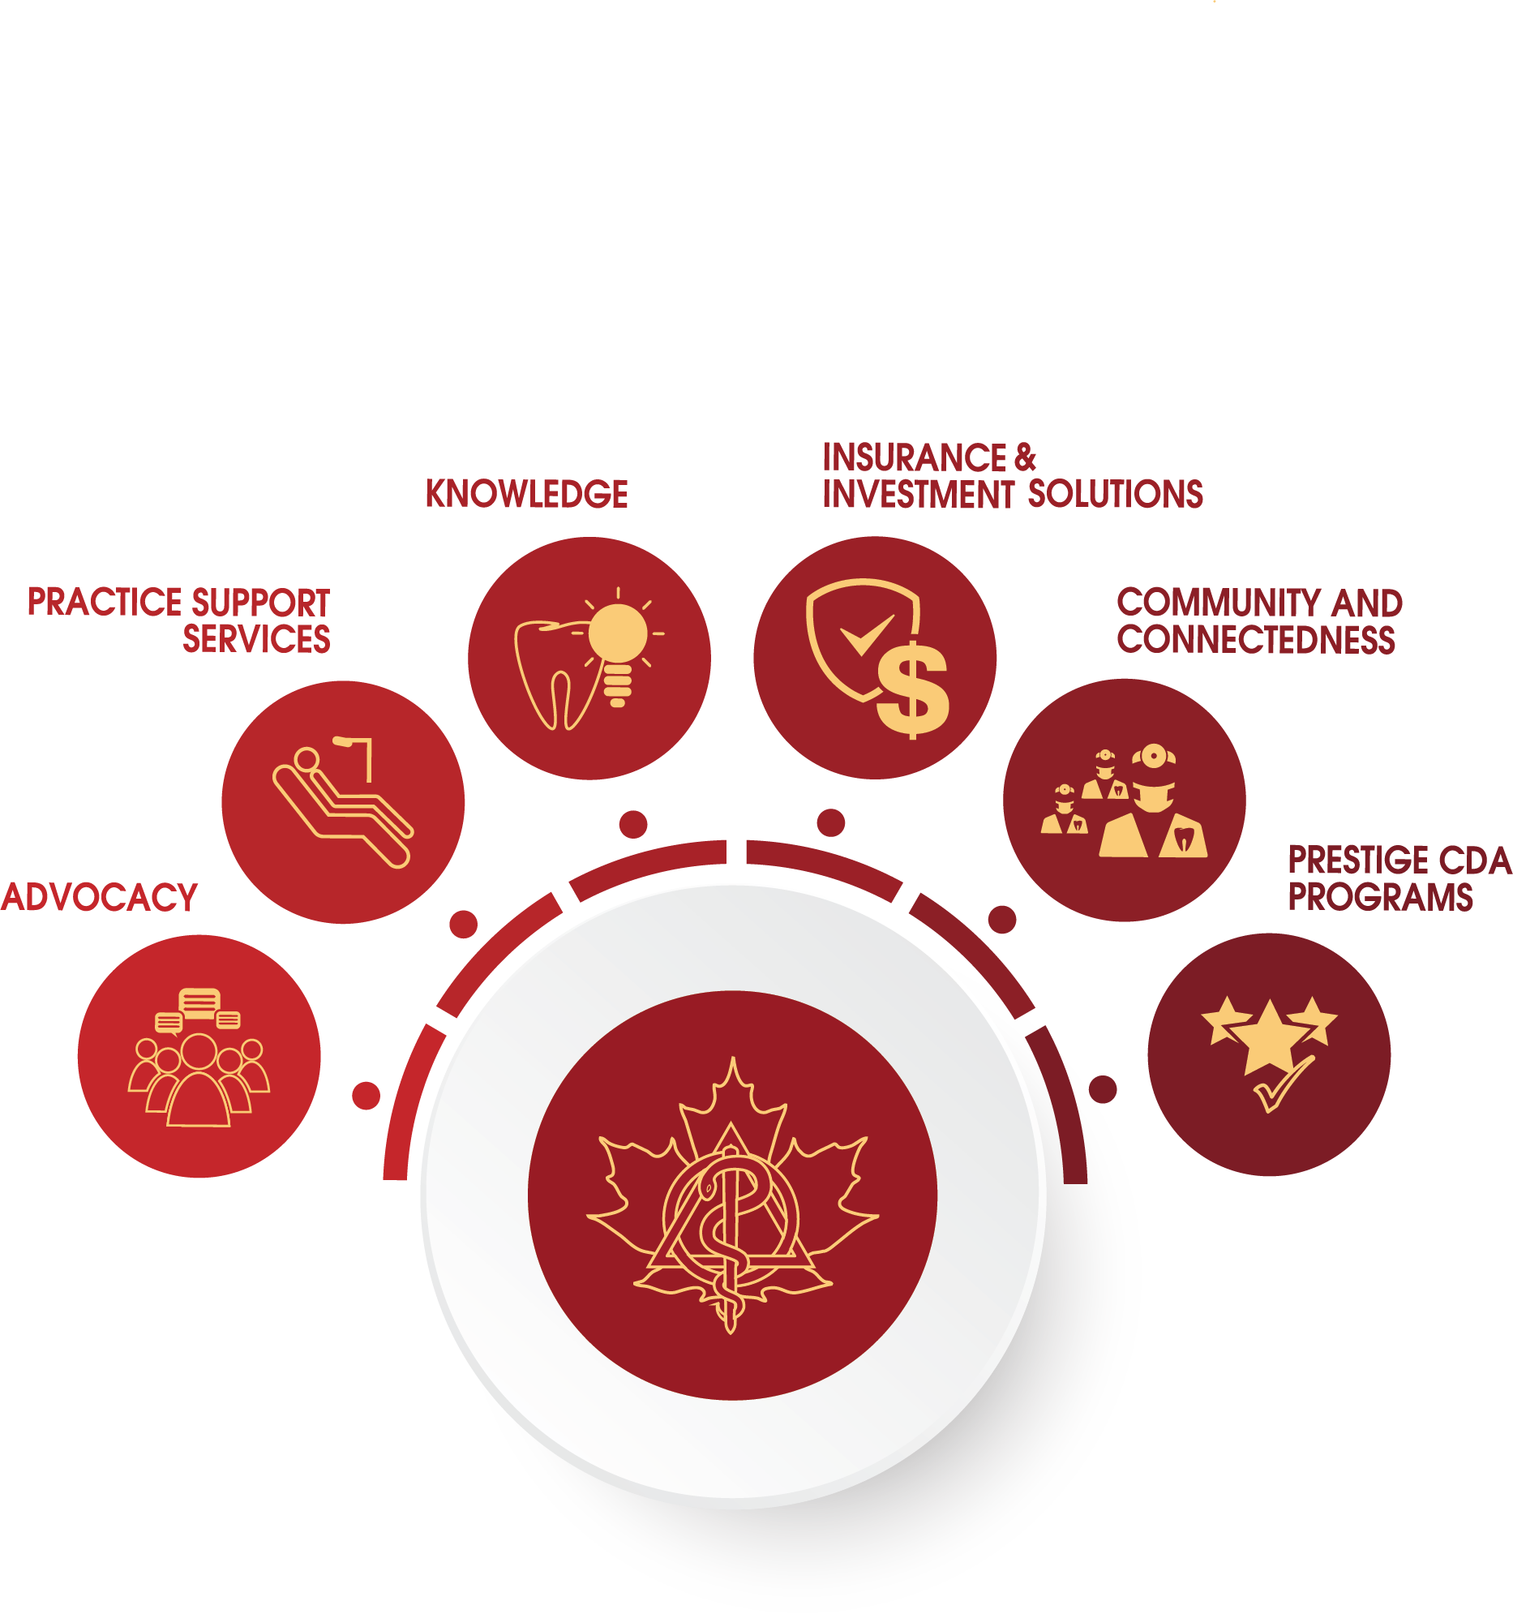
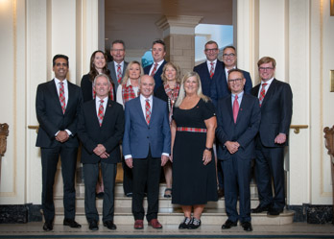
About CDA
Provincial and Territorial Dental Associations (PTDAs) are the Corporate Members of CDA. Dentists in Quebec can join as Affiliate Members
CDA is the National Voice of Canadian Dentistry.
Dentists access CDA membership benefits through their membership with their PTDAs.
Each PTDA has an elected CDA BOARD representative. CDSS is well represented by Dr. Brian Baker.
CDA’s primary areas of focus include:
Advocacy
Knowledge
Practice Support

Slide 4
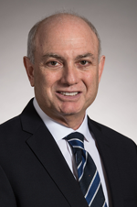
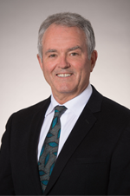
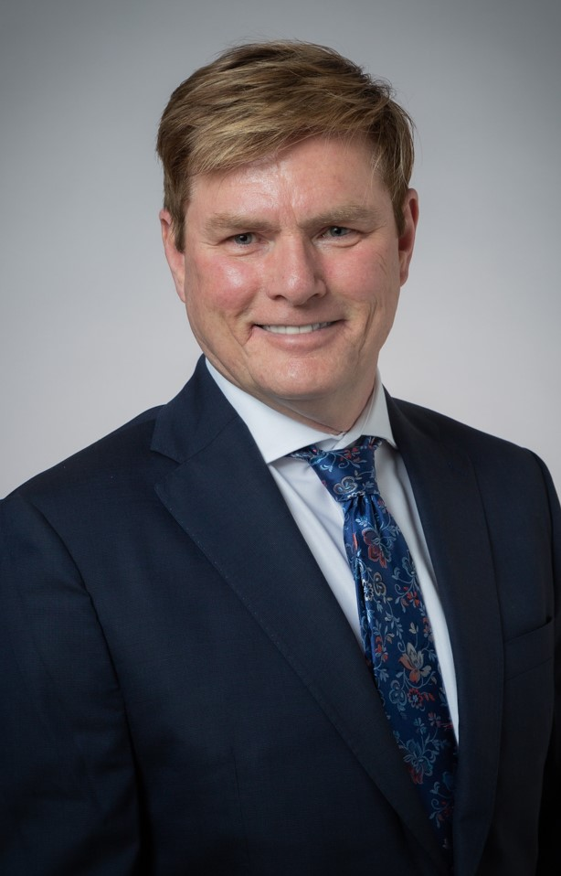
CDA AGM:
Upcoming Changes to CDA Board Subject to their Election
CDA’s Annual General Meeting taking place on April 12, 2024, at the Sheraton Centre.
President 2024-25: Dr. Joel Antel (Winnipeg, Manitoba)
President-Elect 2024-25: Dr. Bruce Ward (Vancouver, British Columbia)
Vice-President 2024-25: Dr. Kirk Preston (Fredericton, New Brunswick)

Slide 5
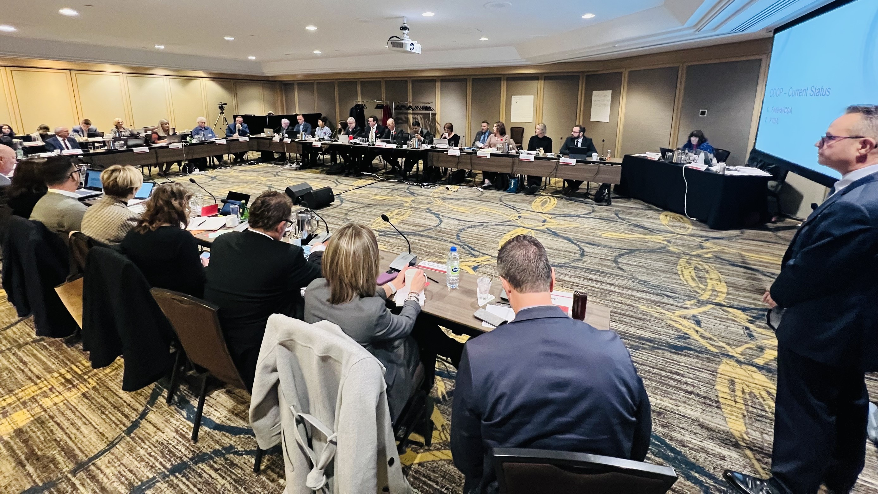
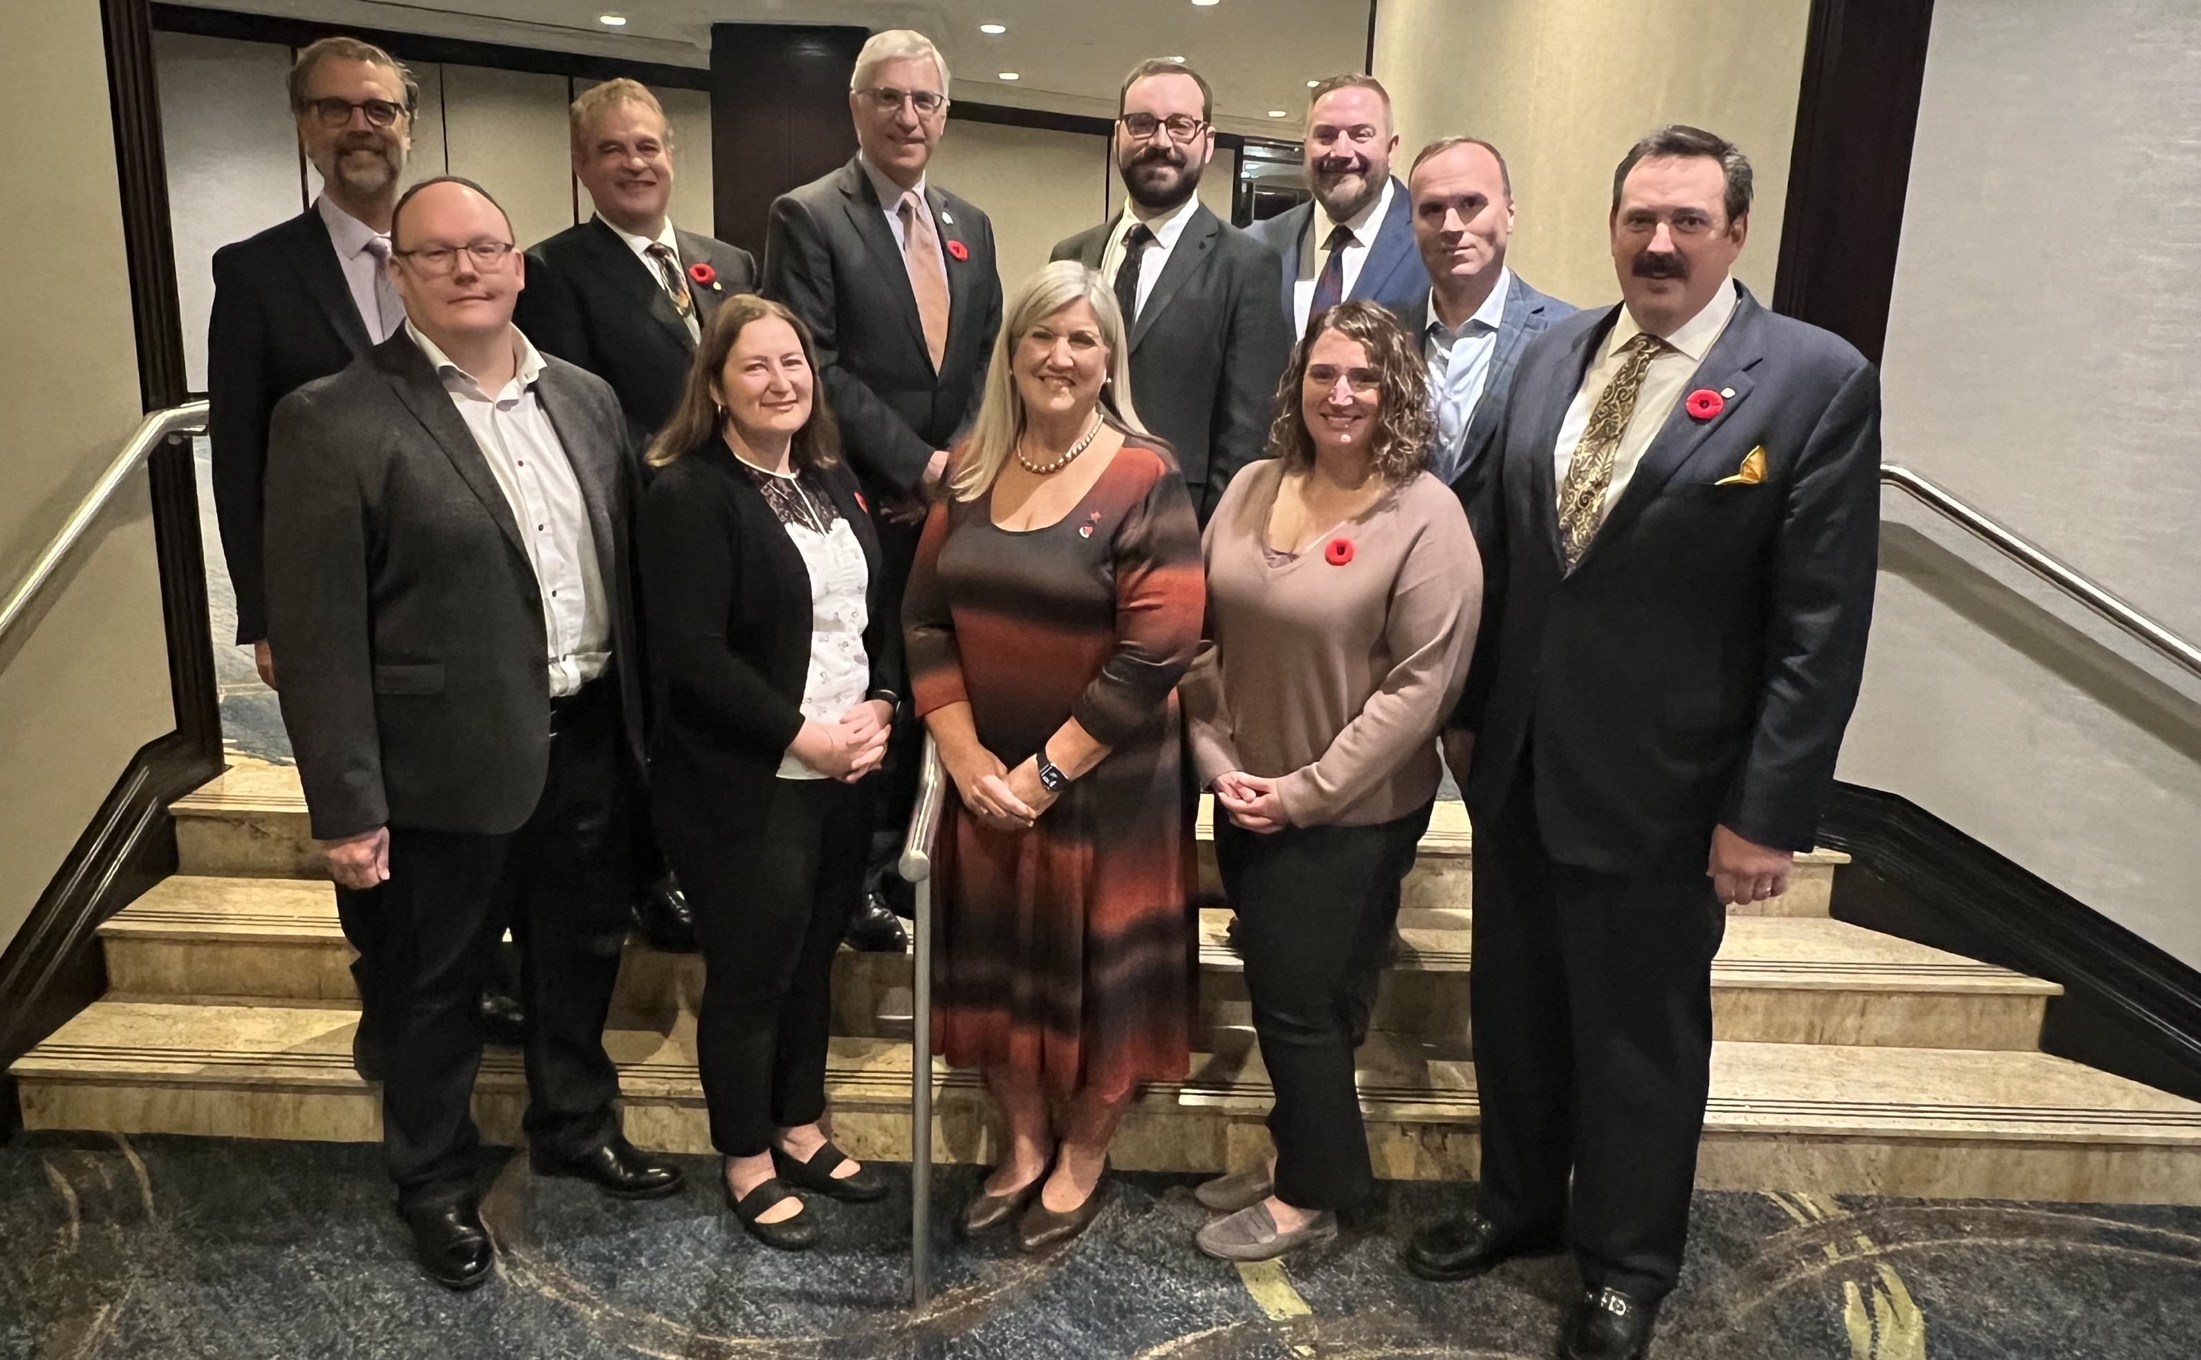
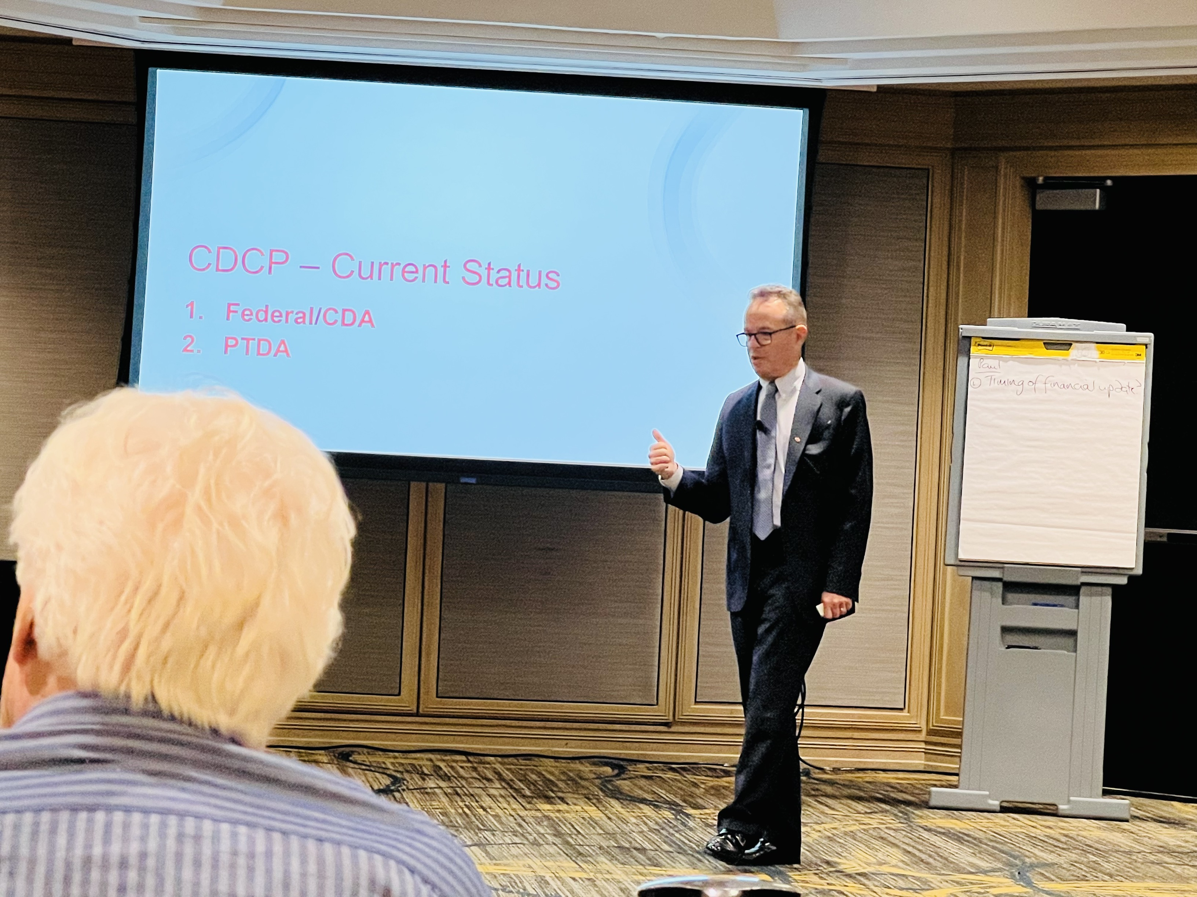
Corporate Members

Slide 6
Dental Specialties

Slide 7
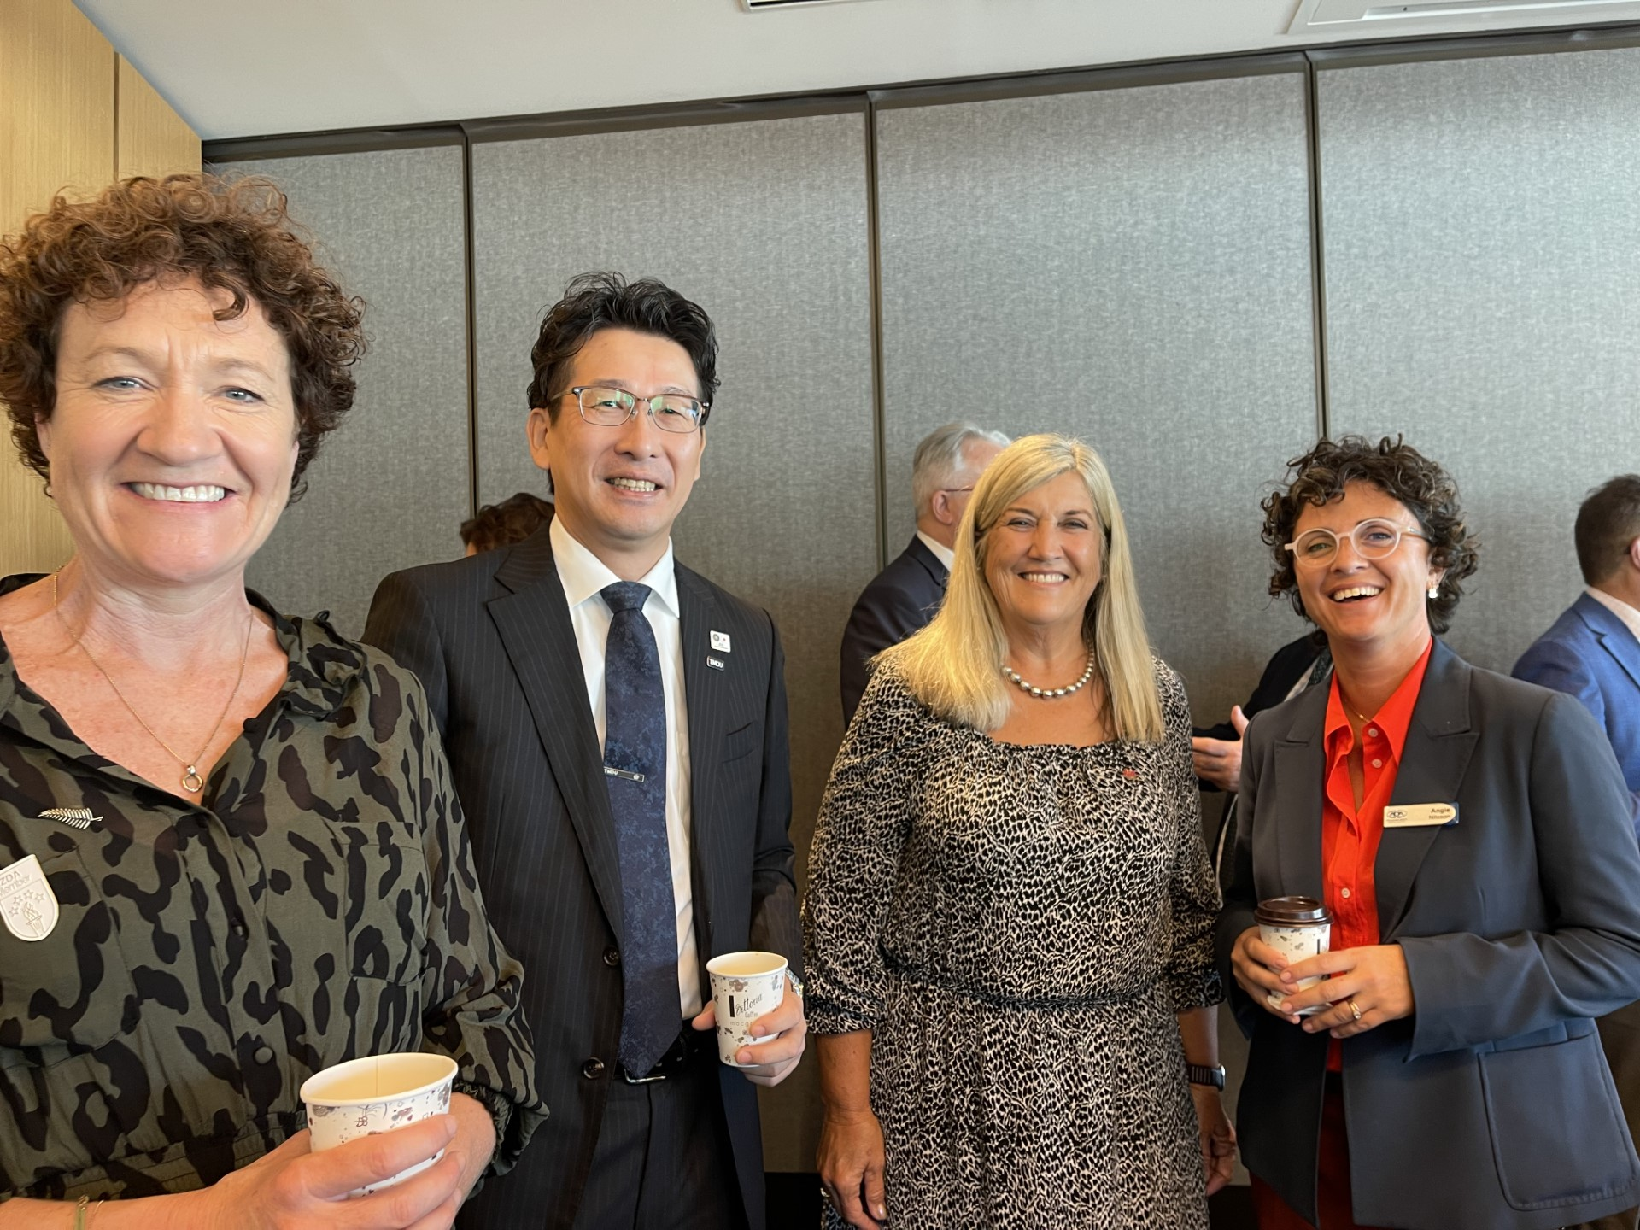
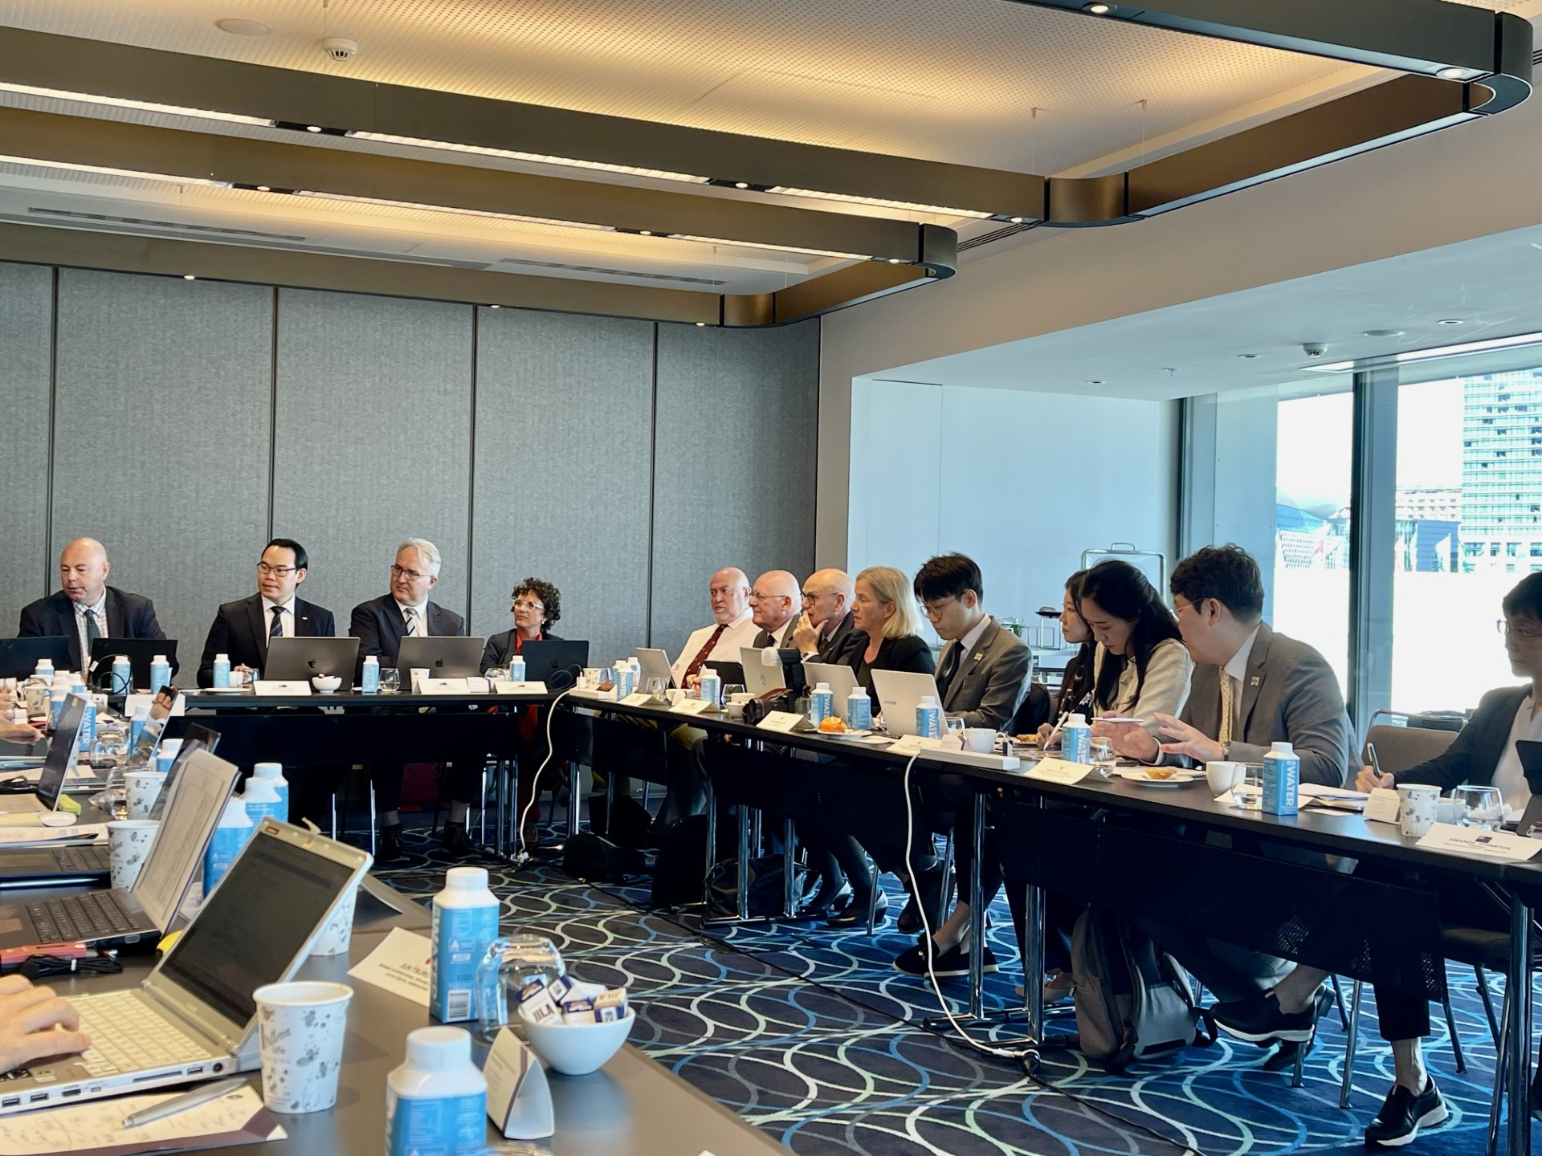
Key Dentistry Partners

Slide 8
Major Health Stakeholders

Slide 9
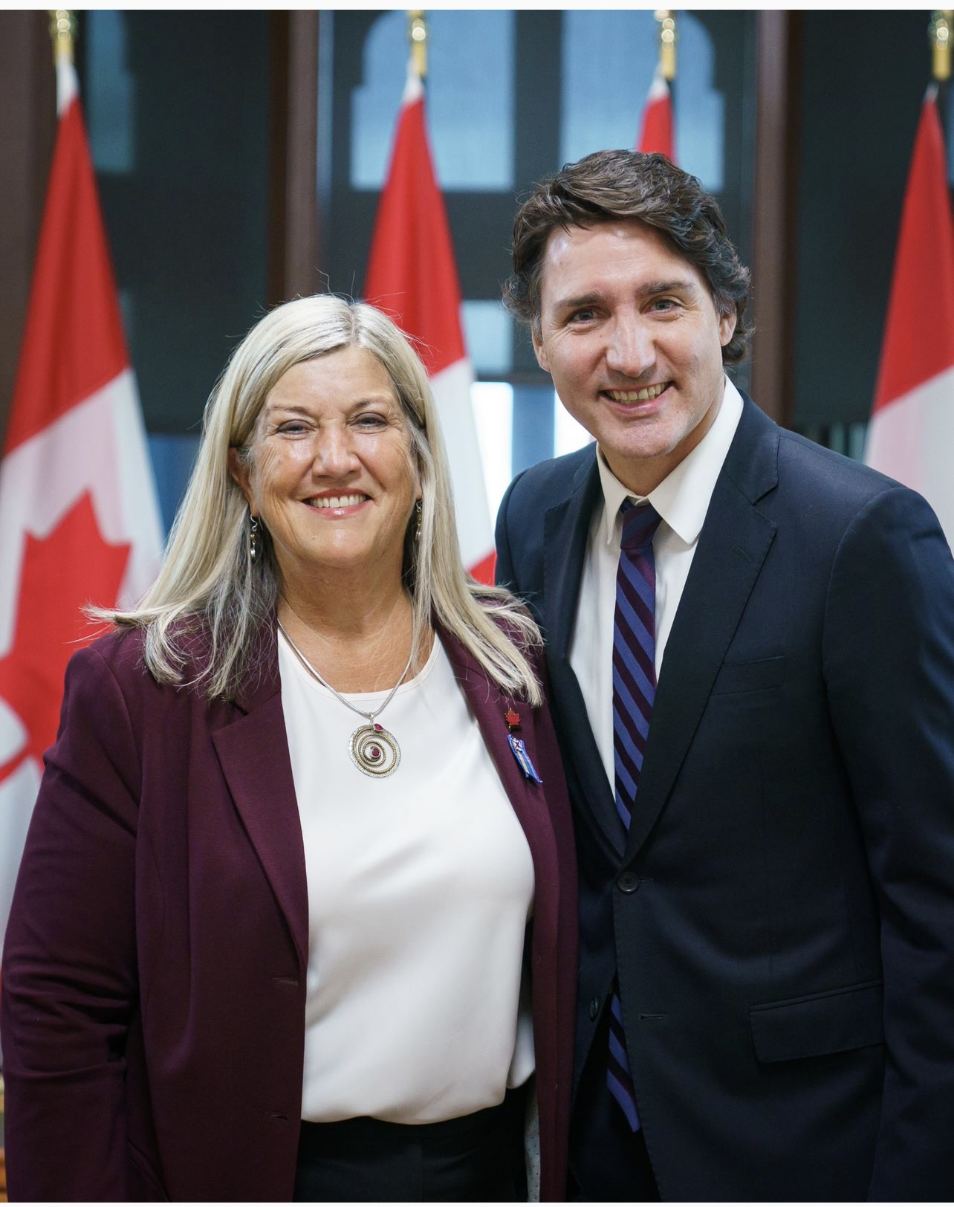
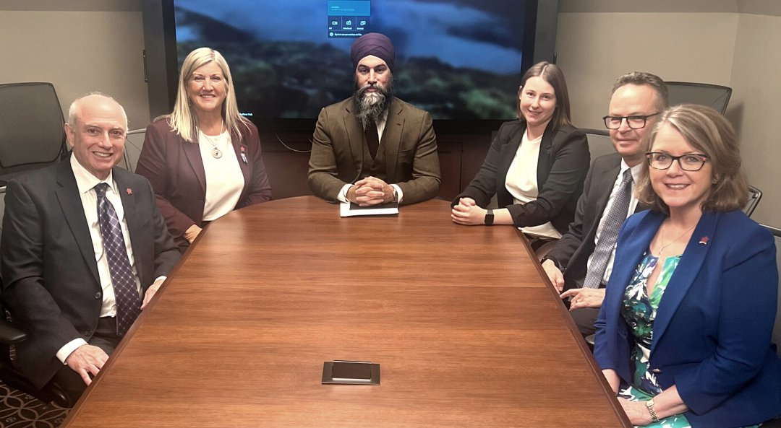
Launching the Canada Dental Benefit
CDA has been advocating to the federal government and working with the PTDAs since the first announcement of a federal dental care plan in early 2022.
December 2022 - the CDB was launched to provide up to $650 per child/year. Over 400,000 have been helped.
The Canada Dental Benefit is an interim program designed to support children under 18 until June 2024.

Slide 11
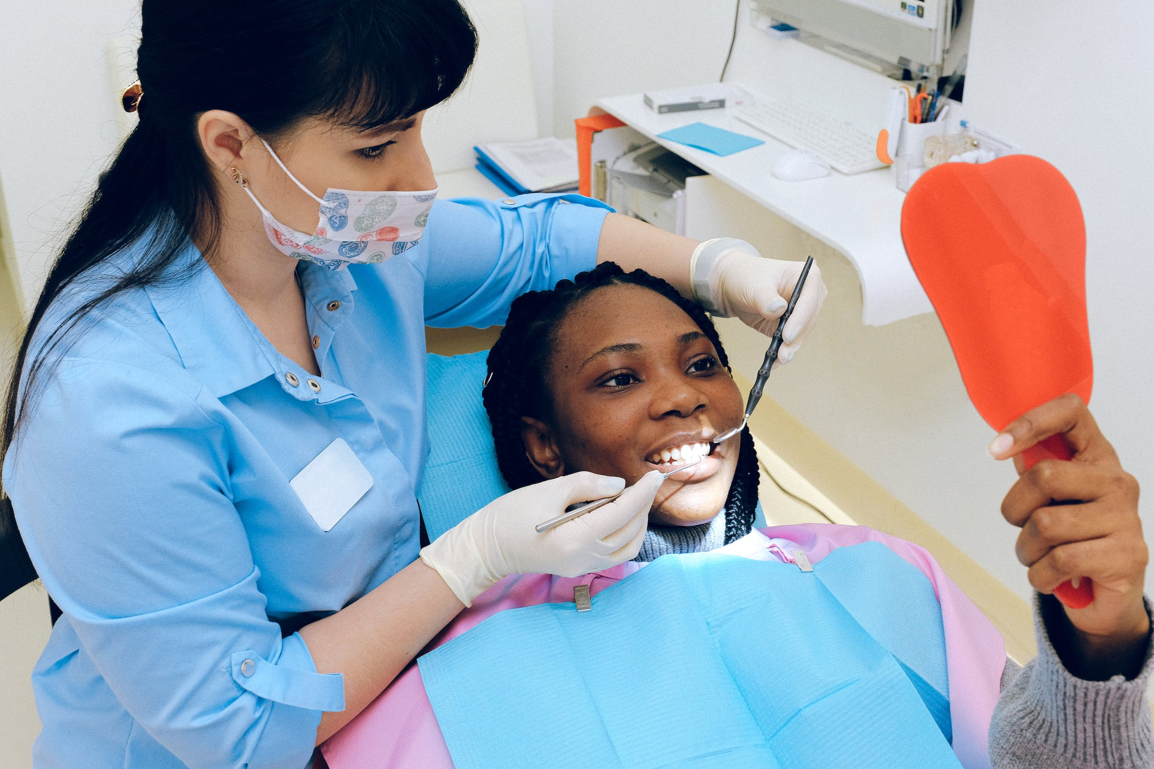
Stats Canada Report- November 2023
35% have not seen a dental professional in the last year (Dec. 2022), 25% due to cost.
Cost was a barrier for visible minorities at a higher proportion than non-racialized populations.
76% with private insurance had dental care in the past 12 months, only 51% without private insurance.
40% without insurance avoided dental care due to cost, just 14% with insurance avoided it due to cost.
34.7% of Canadians aged 12 and over did not have dental insurance in 2022 (StatsCan 2024).

Slide 12
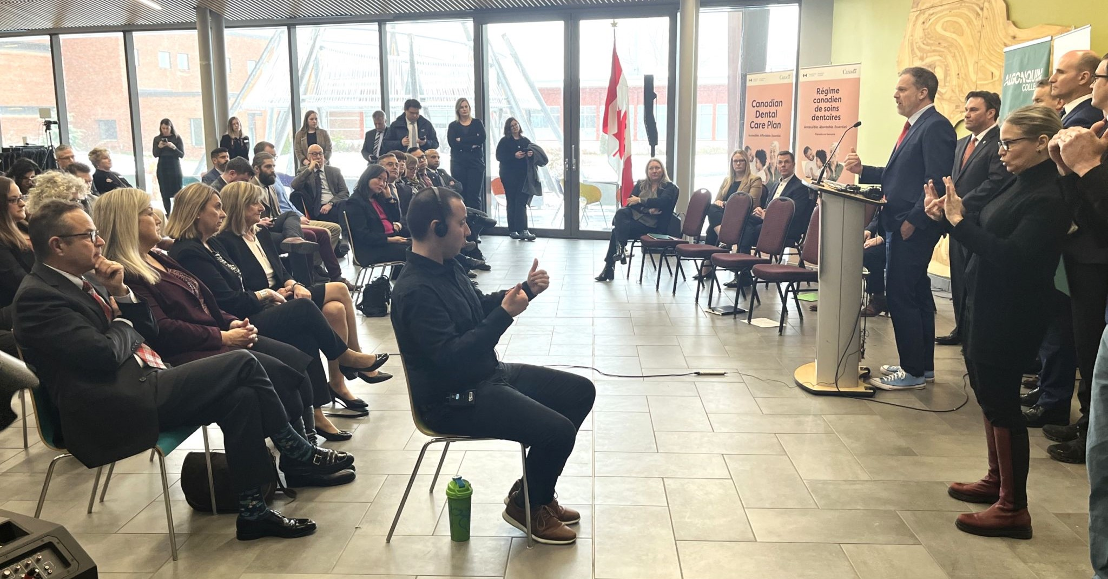
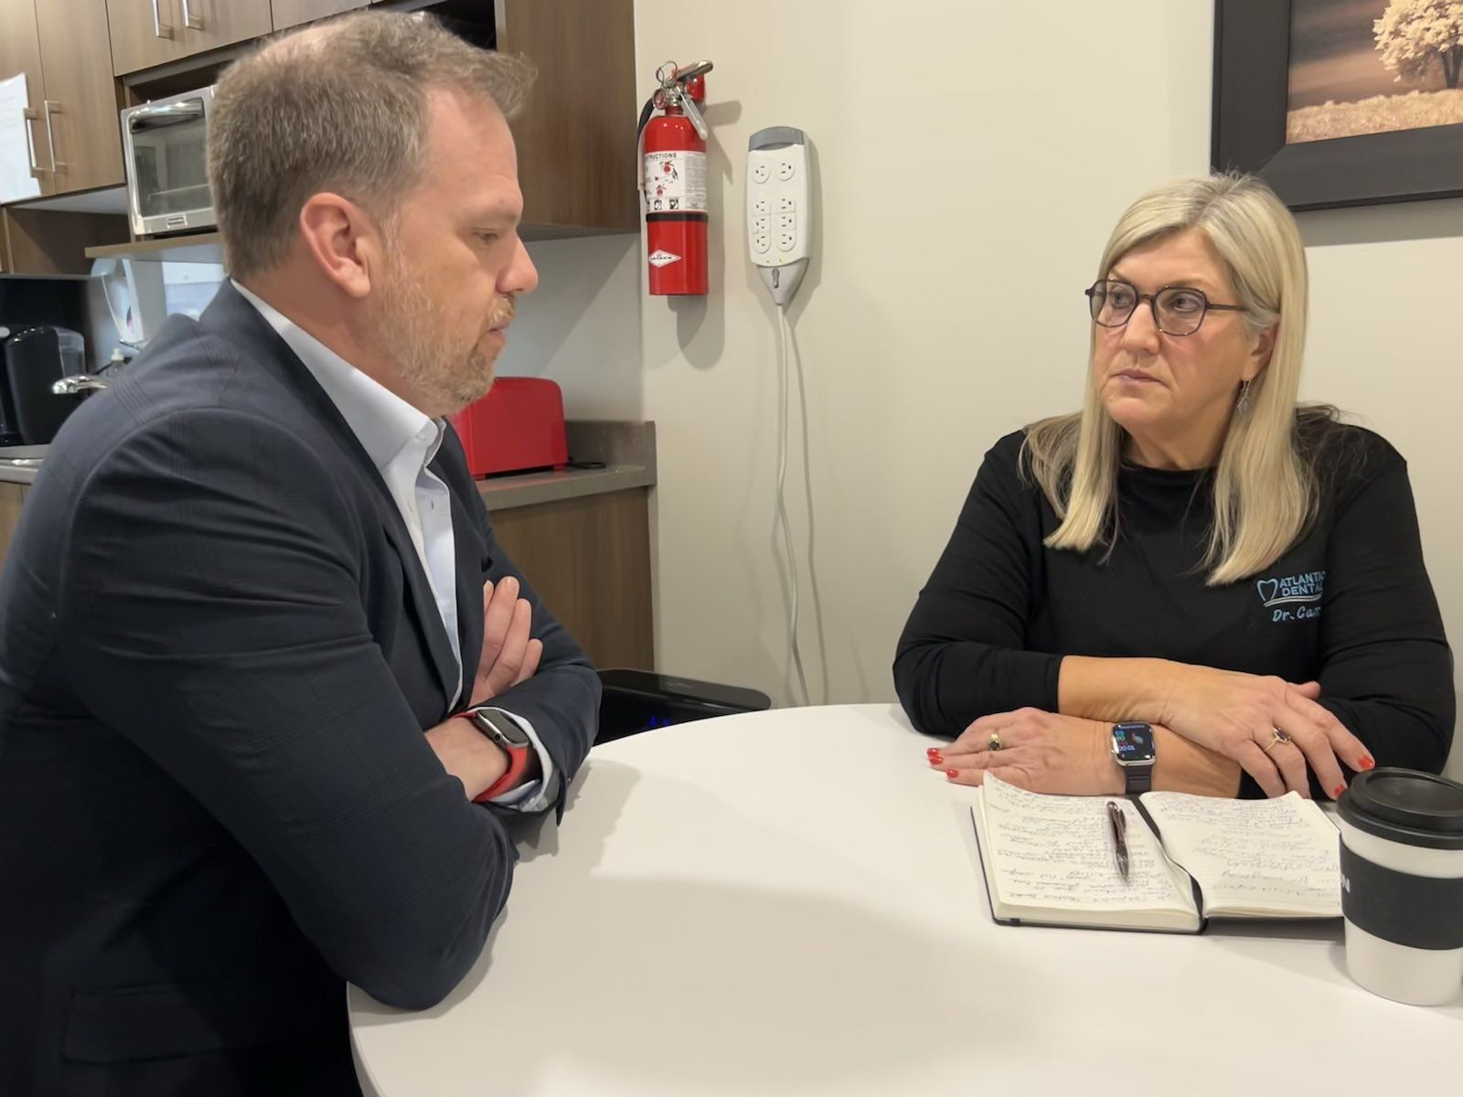
Canadian Dental Care Plan
December 2023: Federal Government announced its phased rollout of the CDCP
February 2024: Federal Government announced further details about the CDCP, including provider agreement and services covered. Met with Minister Holland in Halifax.
March 2024: CDA issued letter to Minister Holland to share cross-country survey results and concerns about provider participation.
CDA worked hard with the PTDAs to ensure that dentists’ voices are heard and that the CDCP would benefit all Canadians who need access to oral health care.

Slide 13
CDA’s Transformational Journey
Governance Review
Internal Realignment​
Strategic Plan

Slide 14
CDA Strategic Plan Journey
1-Plan
2-Consult
3-Draft
4-Refine
5-Publish
March '23
April -June '23
Sept-Dec '23
Jan - March 24
April '24

Slide 15
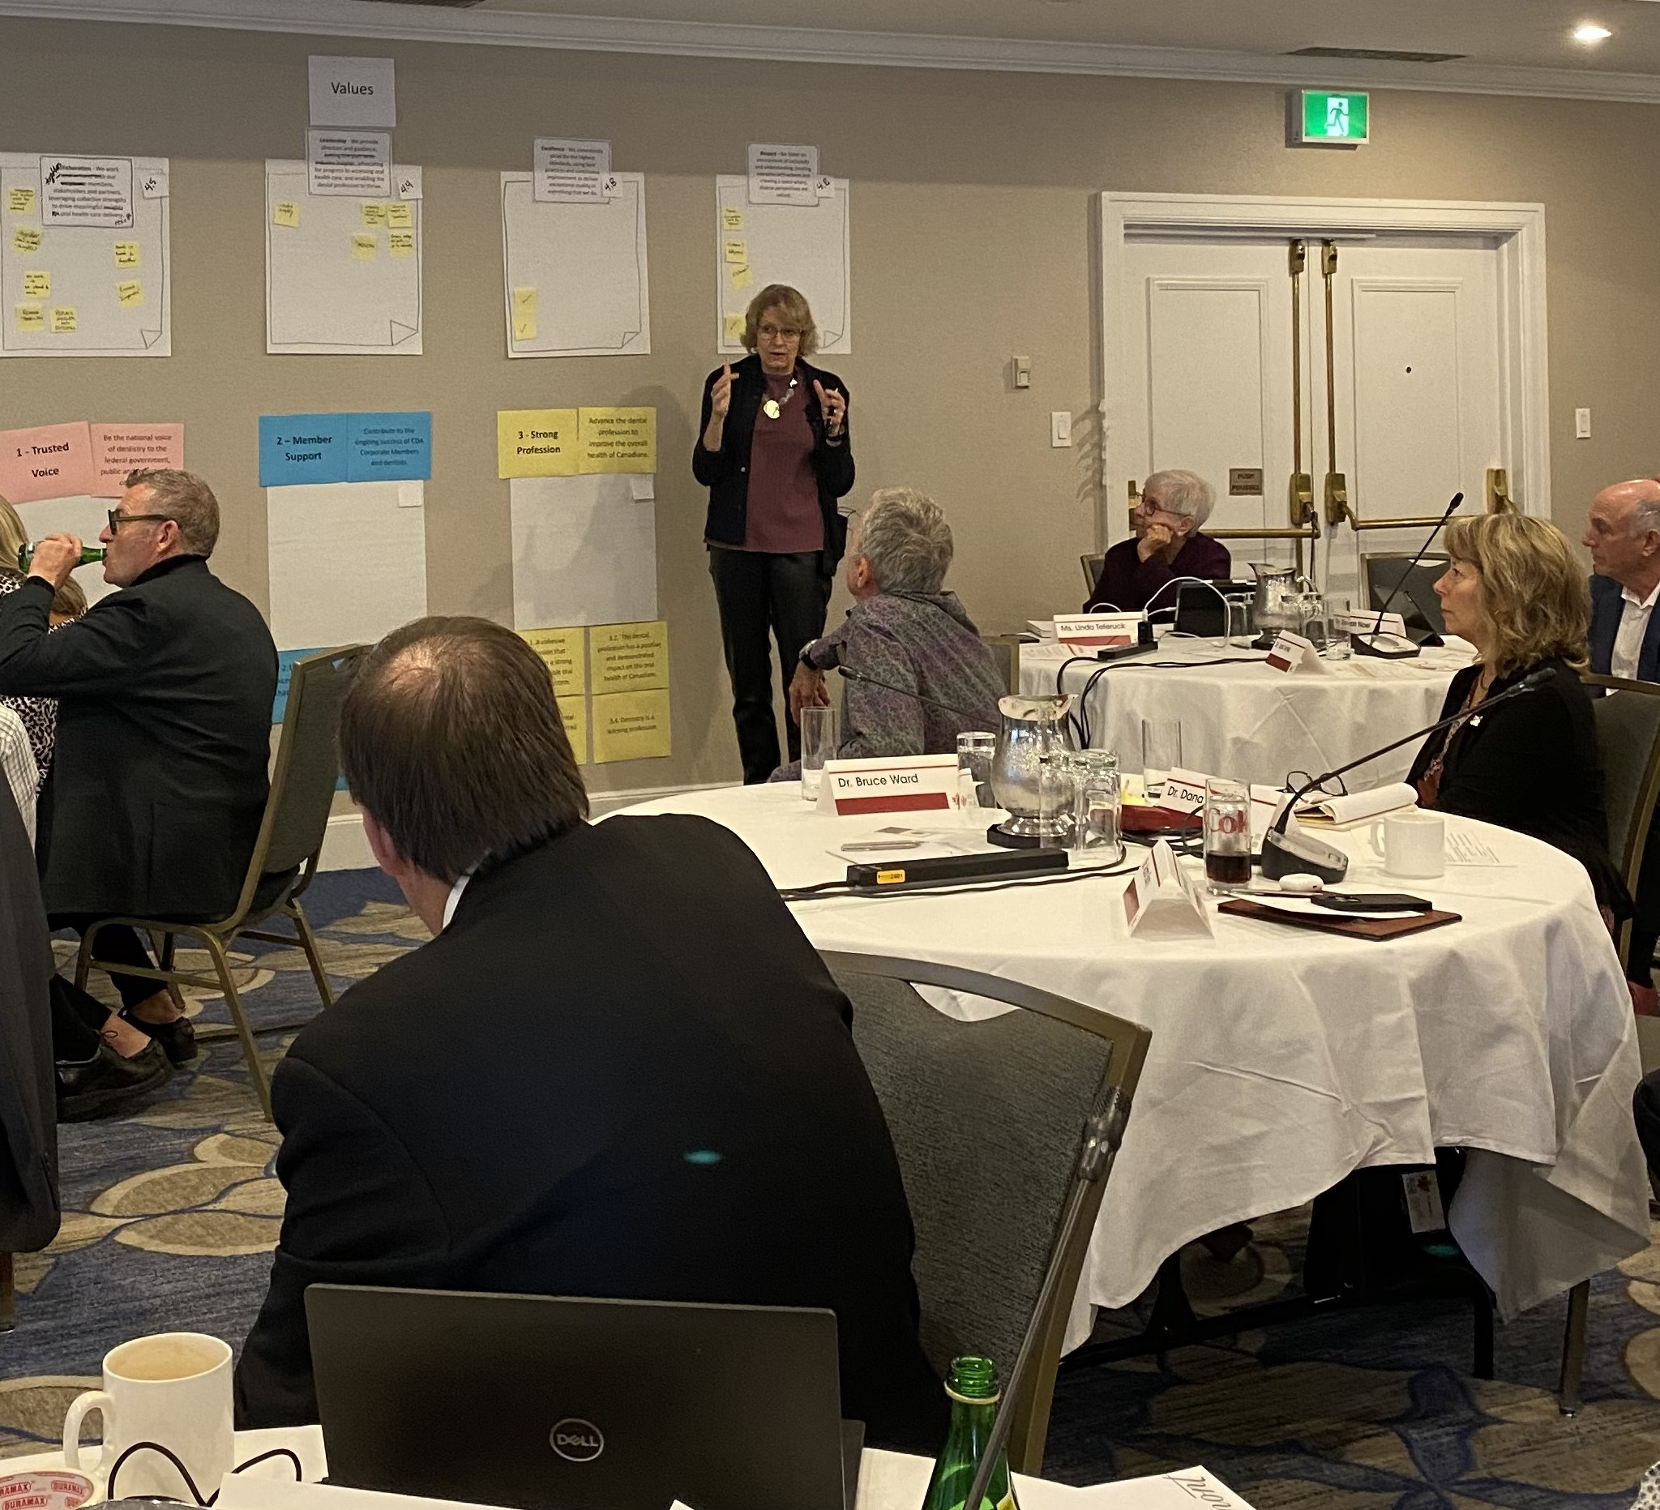
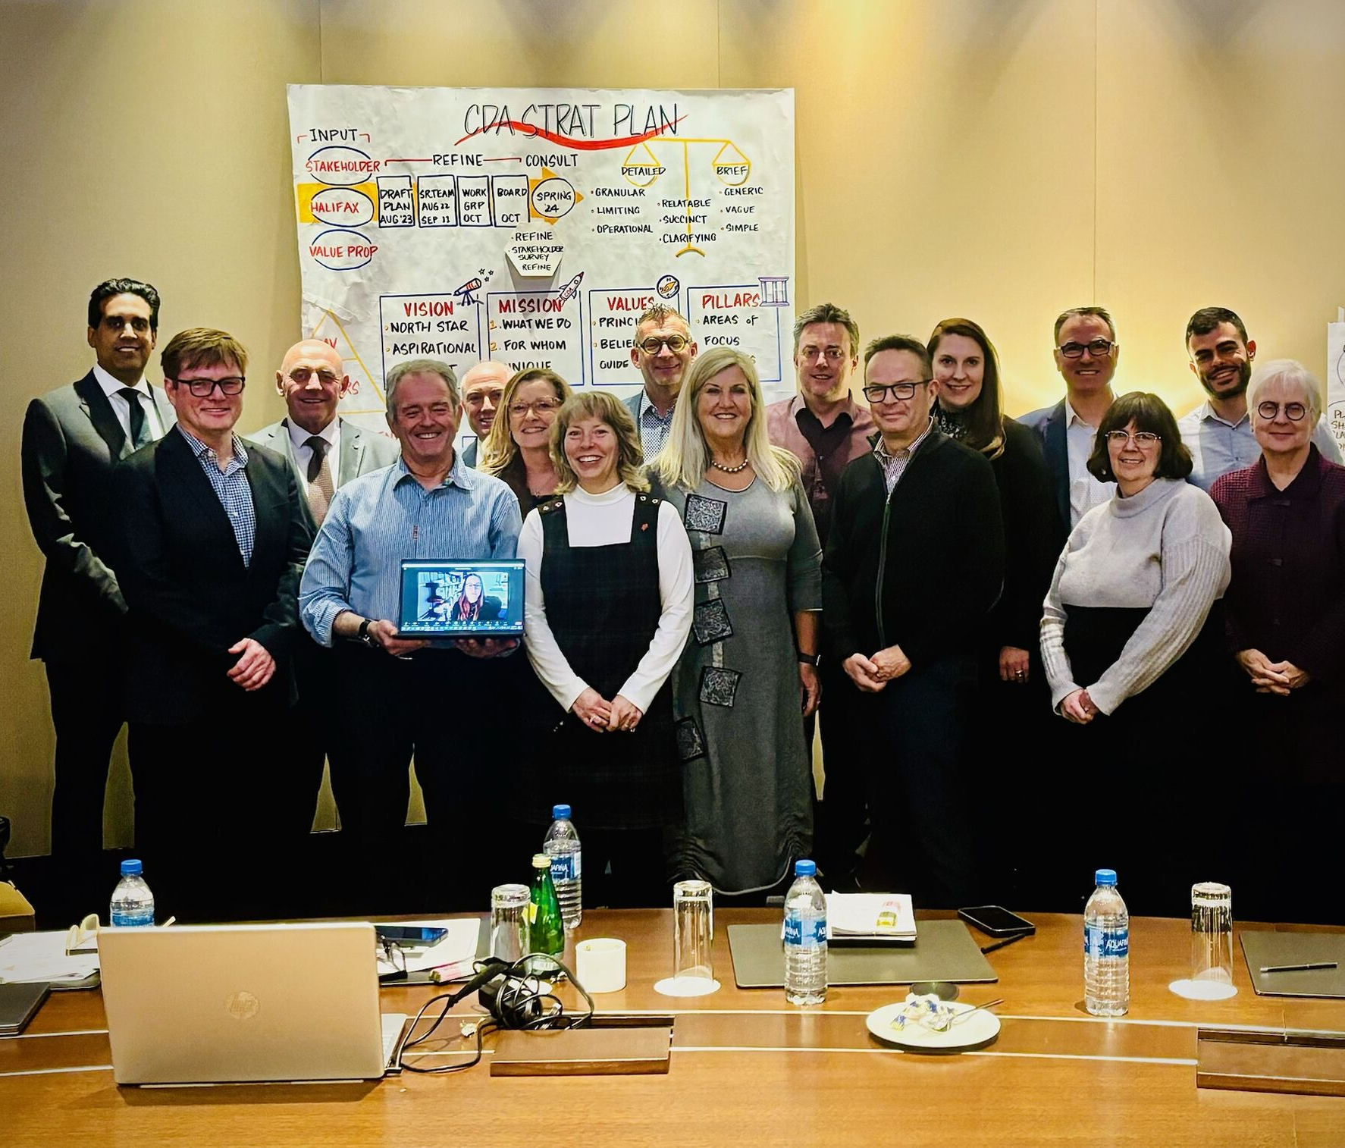
CDA Strategic Plan October/February Workshops

Slide 16
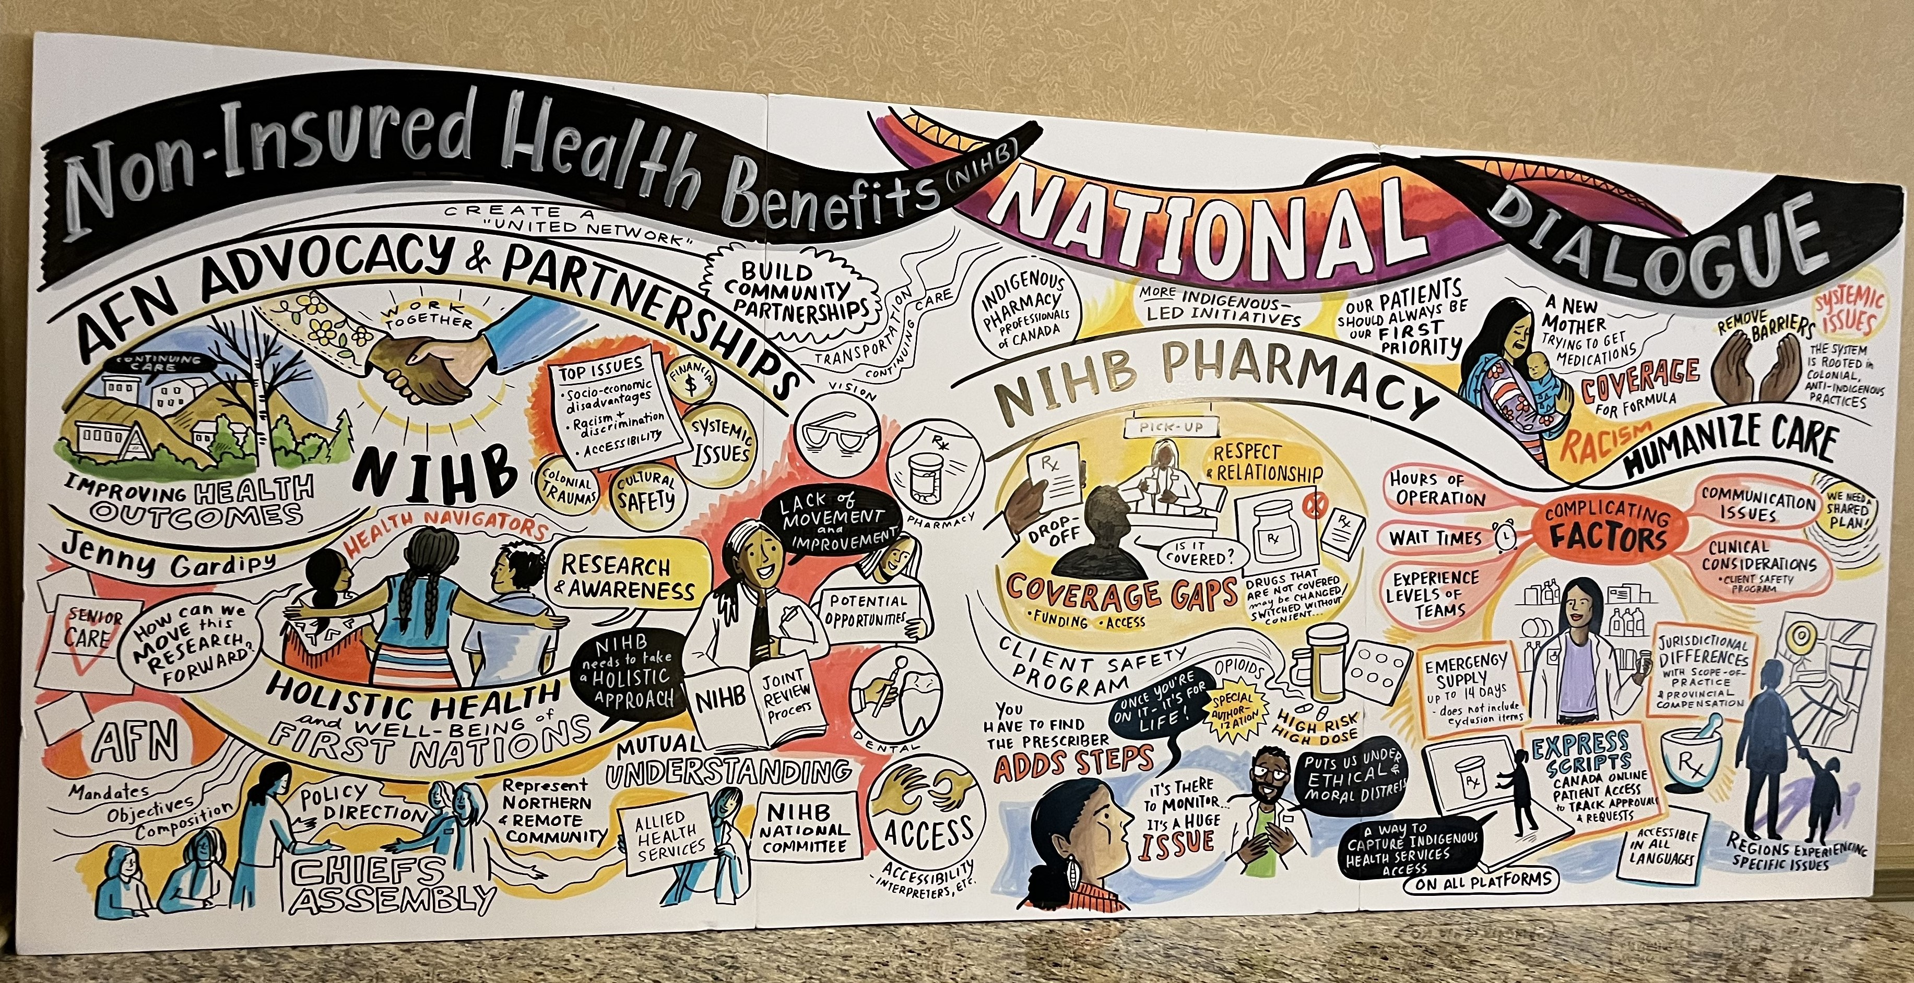
Diversity and Inclusion
Employer Partner of the CCDI:
Corporate members can take advantage of membership at no cost.
PTDAs are already engaging with CCDI.
Listening and Learning:
CEO attended the NIHB roundtable event in Saskatoon to listen and learn about issues related to the NIHB program from Indigenous perspectives.

Slide 17
Promotion of Workplace Mental Health
CDA Partners with MHCC:
The Working Mind course is designed to empower dentists.
PTDAs, dental societies, study clubs and others can sponsor this program for dentists and their teams.

Slide 18
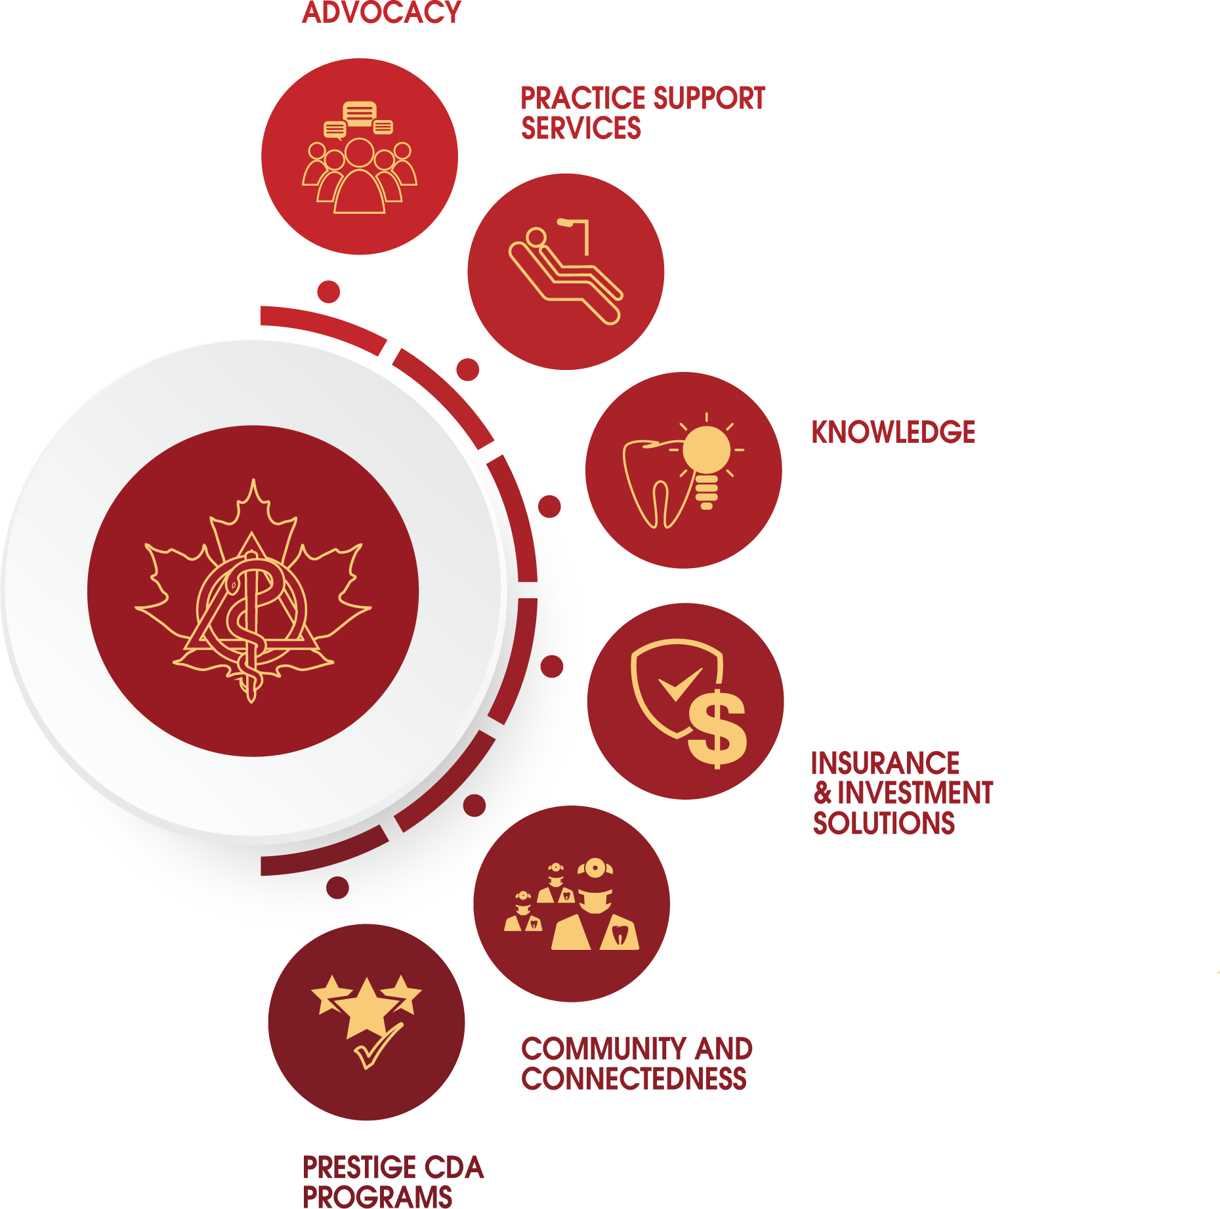
Update on CDA Governance
June 2023: CDA Board approved three new governance policies:
Whistleblower Policy
Board Evaluation and Assessment Policy
Selection of the Chair of the Annual General Meeting Policy
October 2023: The Board approved amendments to CDA’s Code of Conduct Policy to align with the Whistleblower Policy.
October 2023: The Board approved an information sharing framework.

Slide 19
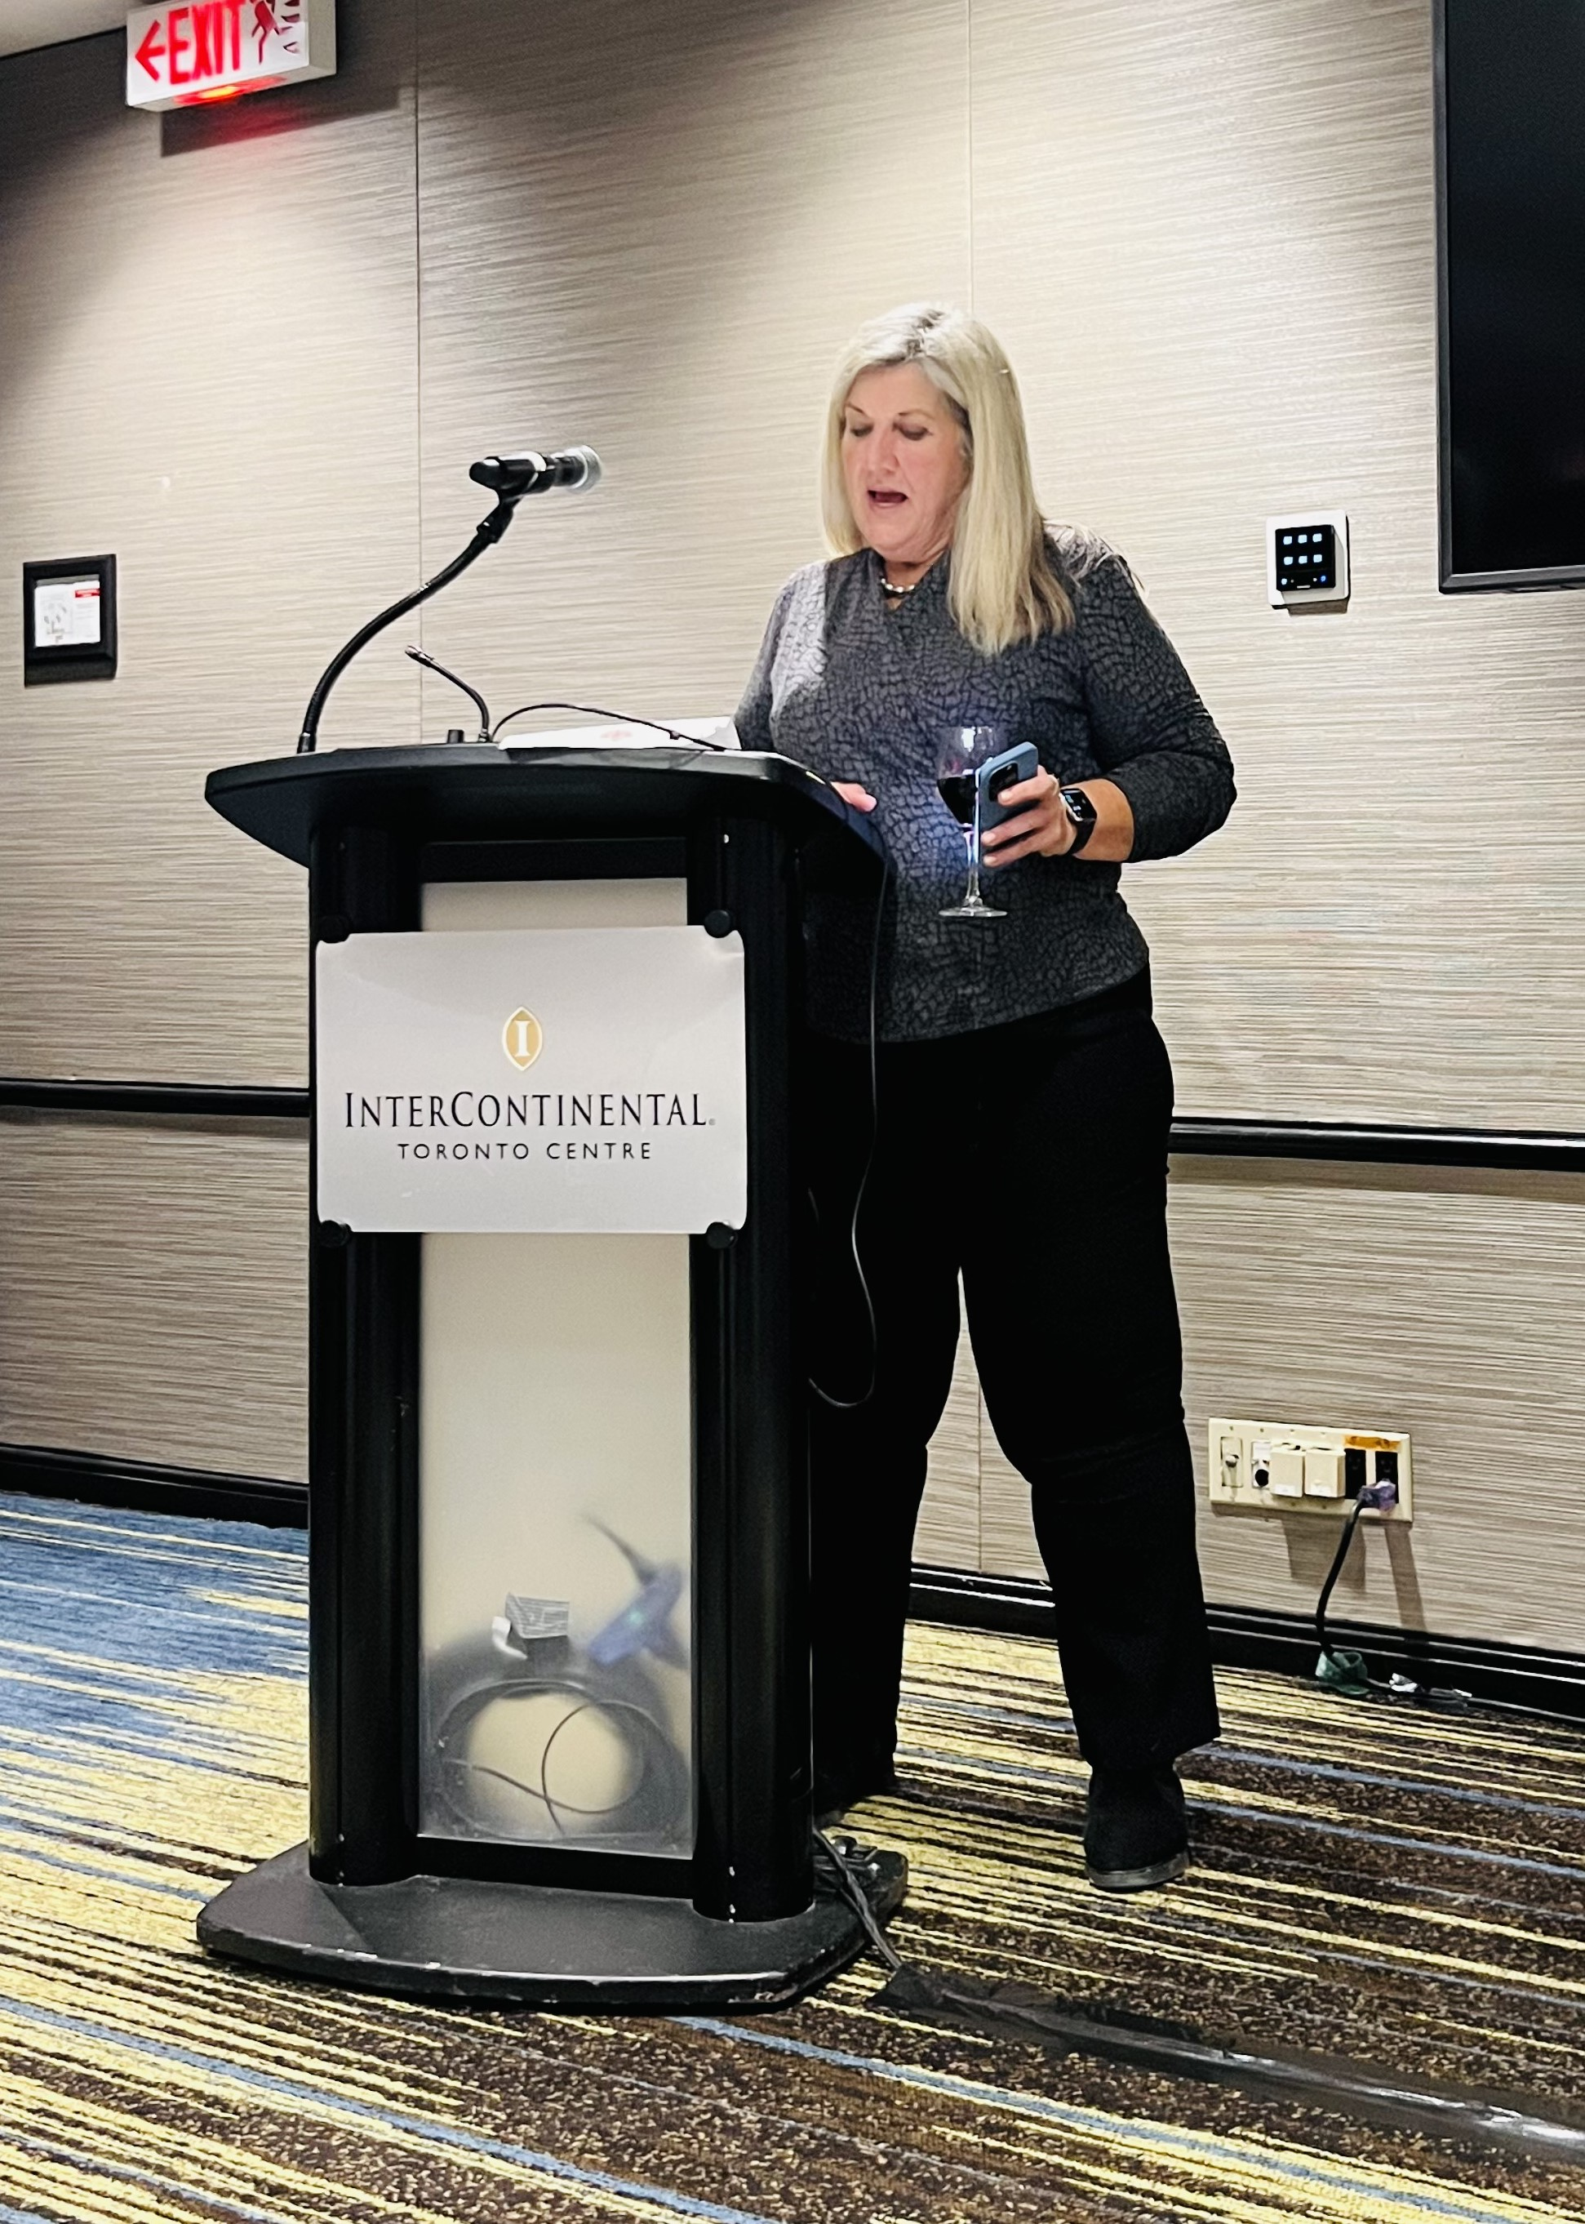
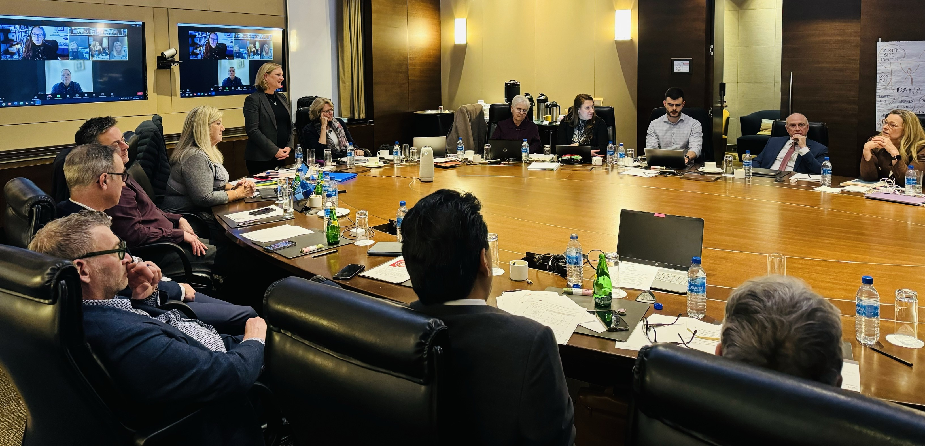
More CDA Governance Updates
February 2024:
Approved a proposed framework for renewed international strategy
Dr. Jim Armstrong’s term renewed- Voting rep to CDSPI AGM and Corporate Member Council
Approved 2024 award recipients

Slide 20
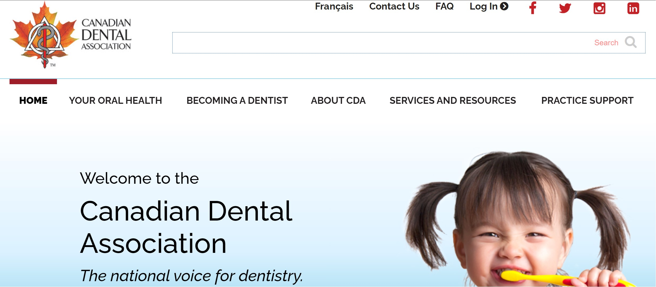
Stay Connected on CDA-ADC.ca

Slide 21
The Canadian Dental Association
www.CDA-ADC.ca

