Slide 1
CDSS JUNE COUNCIL MEETING
Friday, June 2, 2023
Dakota Dunes Resort
Hon. Paul Merriman

Slide 2
ACKNOWLEDGEMENT
We acknowledge that the College of Dental Surgeons of Saskatchewan is located on Treaty 6 Territory and the Homeland of the Metis. We pay our respects to the First Nations and Metis ancestors of this place and reaffirm our relationship with one another.

Slide 3
GUIDING PRINCIPLE
CDSS is a dental regulatory body that regulates dentists 'by the right of the Minister of Health', Government of Saskatchewan, via the Dental Disciplines Act (1997). This is to say the Government delegates, through legislation, the responsibility to the CDSS to license and regulate dentists in Saskatchewan 'in the public interest'.

Slide 4
VISION
Safely serve the public.
MISSION (STRATEGIES)
License new entrants
Regulate members
Provide continuous education
Implement current best practices
VALUES
SAFETY
INTEGRITY
PROFESSIONAL
FULFILLING
GOVERNED BY SAFETY
Ensure public and patient safety at all times.
TRUSTED AND RESPECTED
Reputable organization in the eyes of the public, government, profession and members.
HIGH STANDARDS
Impartial, objective, transparent and fair policies and procedures.
PROFESSION
OF CHOICE
Opportunity to learn, grow, succeed and improve the lives of others.

Slide 5
CDSS STAFF
Registrar - TBD
Jaime Korczak
Executive Director
Jessica Gunn
Coordinator Licensing & Renewals
Meagan Fraser
Communications and Marketing Specialist
Lisa Cassidy
Coordinator of Professional Standards and Complaint Process
MANAGEMENT & STAFF

Slide 6
ELECTED COUNCIL MEMBERS
Dr. Aaron Bazylak, Saskatoon, President
Dr. Derek Thiessen, Swift Current, President-Elect
Dr. Michael Fowler, Regina, Vice-President
Dr. Raj Bhargava, Saskatoon
Dr. Bil Hussain, Unity
Dr. Michael Koskie, Yorkton
Dr. Drew Krainyk, Regina
Dr. Jay Lalli, Saskatoon
Dr. Erika Ridgway, Saskatoon
Dr. Kevin Saganski, Saskatoon
Dr. Wes Thomson, Assiniboia

Slide 7
SASKATCHEWAN PUBLIC REPRESENTATIVES
Silvia Martini, Saskatoon
Don Robinson, Swift Current
Gord Wyatt, Indian Head
OTHER REPRESENTATIVES
Dr. Brian Baker—Board of Directors, Canadian Dental Association
Dr. Walter Siqueira—Dean, College of Dentistry, University of Saskatchewan
Dr. Stéfan Piché—Board of Directors, National Dental Examining Board
Dr. Bernie White—Senate, University of Saskatchewan
Gord Gillespie—ICD.D, CDSS Council Chair

Slide 8
LICENSURE STATISTICS

Slide 9
LICENSING NUMBERS BY YEAR

Slide 10
DENTISTS BY SPECIALTY

Slide 11
DENTISTS PER TOP 5 CITIES

Slide 12
RURAL DENTISTS (231)
*One dentist could be working out of more than one clinic.

Slide 13
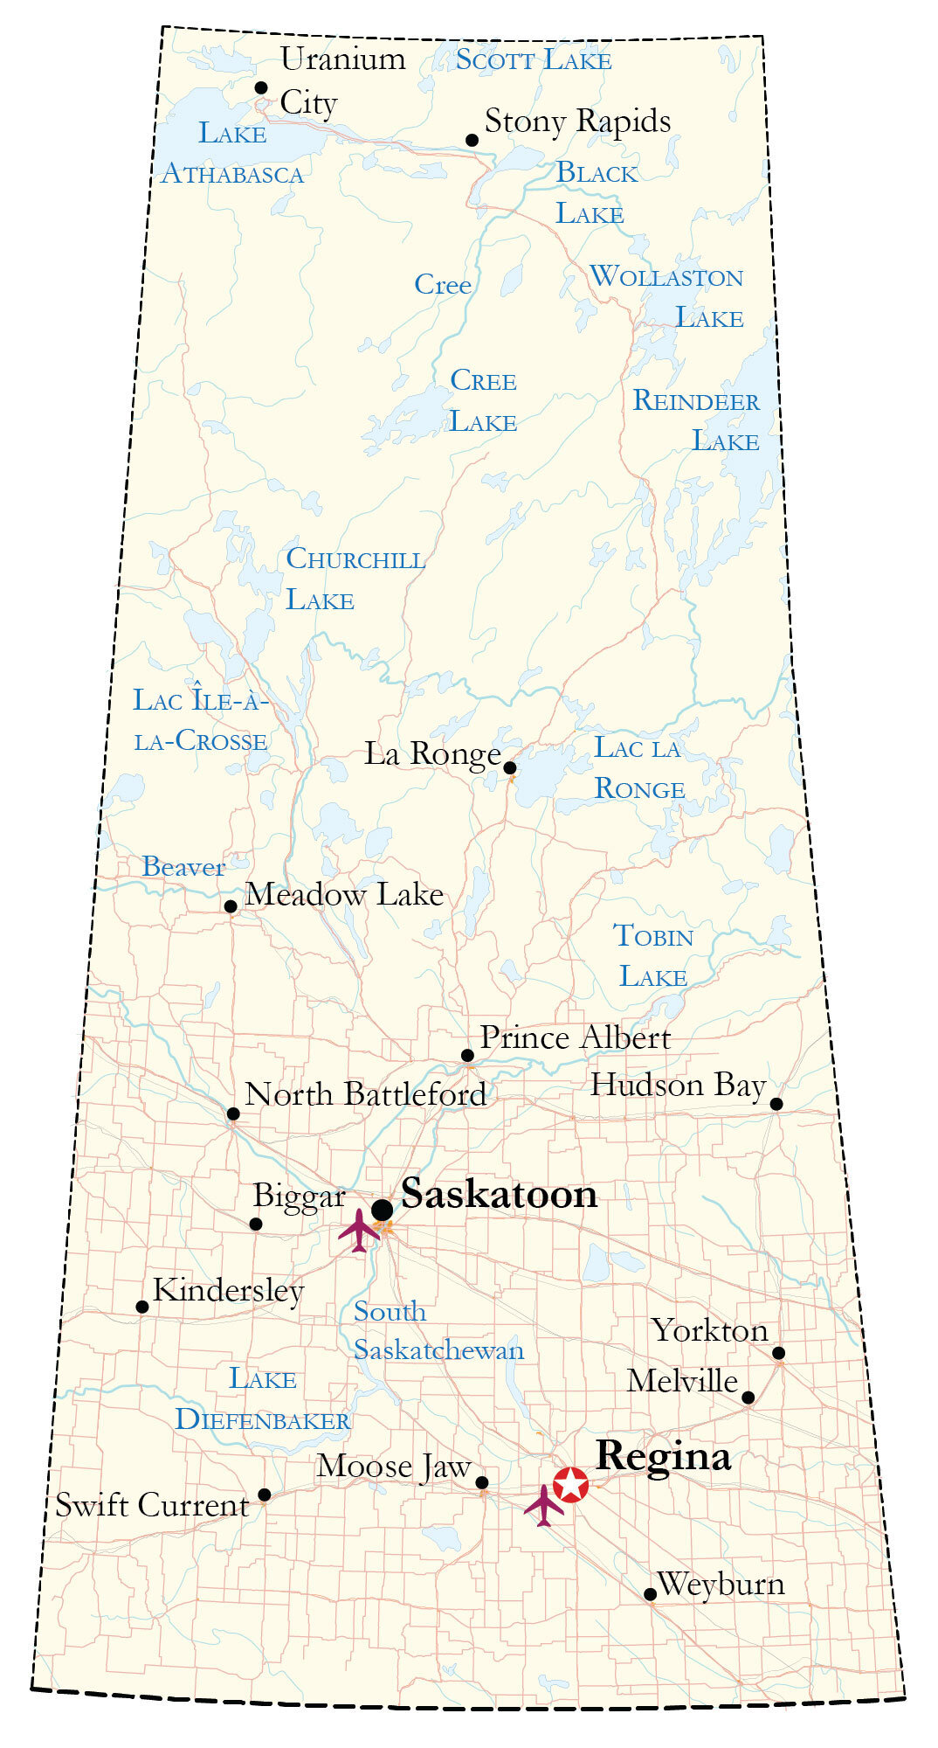
CLINICS BY REGION

Slide 15
STANDARDS
Advanced Facial Esthetic Therapies and Adjunctive Considerations
CDSS Long Term Care Resident Guidelines
CDSS Sedation and General Anesthesia Standard

Slide 16
FEE GUIDE NEGOTIATIONS
Supplemental Health
Payment Schedule Modernization
General Practitioner and
Specialist Fee Guide

Slide 17
THANK YOU

