Slide 1
CDSS SPRING COUNCIL MEETING
Monday, March 25th, 2024
Double Tree Hotel – Regina, SK
Hon. Everett Hindley

Slide 2
ACKNOWLEDGEMENT
The College of Dental Surgeons of Saskatchewan acknowledges that we operate on Treaty 6 territory and additionally act in the public’s interest on Treaty 2, 4, 5, 8, and 10.
We acknowledge the truth of our past, its place in our present and the ongoing impact it has on our future.

Slide 3
GUIDING PRINCIPLE
CDSS is a dental regulatory body that regulates dentists 'by the right of the Minister of Health', Government of Saskatchewan, via the Dental Disciplines Act (1997). This is to say the Government delegates, through legislation, the responsibility to the CDSS to license and regulate dentists in Saskatchewan 'in the public interest'.

Slide 4
VISION
Safely serve the public.
MISSION (STRATEGIES)
License new entrants
Regulate registrants
Provide continuous education
Implement current best practices
VALUES
SAFETY
INTEGRITY
PROFESSIONAL
FULFILLING
GOVERNED BY SAFETY
Ensure public and patient safety at all times.
TRUSTED AND RESPECTED
Reputable organization in the eyes of the public, government, profession and registrants.
HIGH STANDARDS
Impartial, objective, transparent and fair policies and procedures.
PROFESSION
OF CHOICE
Opportunity to learn, grow, succeed and improve the lives of others.

Slide 5
CDSS STAFF
MANAGEMENT & STAFF
Dr. Dean Zimmer
Registrar
Jaime Korczak
Executive Director
Jessica Gunn
Executive Assistant
Lisa Cassidy
Senior Coordinator of Professional Standards and Complaint Process
Morgan Molde
Administrative Licensing Coordinator
Dayzia Twordik
Practice Enhancement Coordinator

Slide 6
ELECTED COUNCIL MEMBERS
Dr. Derek Thiessen, Swift Current, President
Dr. Michael Fowler, Regina, President-Elect
Dr. Raj Bhargava, Saskatoon, Vice President
Dr. Michael Koskie, Yorkton
Dr. Erika Ridgway, Saskatoon
Dr. Kevin Saganski, Saskatoon
Dr. Wes Thomson, Kamsack
Dr. Kabir Virdi, Saskatoon

Slide 7
SASKATCHEWAN PUBLIC REPRESENTATIVES
Don Robinson, Swift Current
Gord Wyatt, Indian Head
OTHER REPRESENTATIVES
Dr. Brian Baker—Board of Directors, Canadian Dental Association
Dr. Walter Siqueira—Dean, College of Dentistry, University of Saskatchewan
Dr. Stéfan Piché—Board of Directors, National Dental Examining Board
Dr. Bernie White—Senate, University of Saskatchewan
Gord Gillespie—ICD.D, CDSS Council Chair

Slide 8
LICENSURE STATISTICS

Slide 9
LICENSING NUMBERS BY YEAR

Slide 10
DENTISTS BY SPECIALTY

Slide 11
DENTISTS PER TOP 5 CITIES

Slide 12
RURAL DENTISTS (231)
• Air Ronge
• Assiniboia
• Biggar
• Black Lake
• Canoe Narrows
• Canora
• Carlyle
• Central Butte
• Clearwater
• Crossmount
• Cumberland House
• Davidson
• Debden
• Delisle
• Deschambault Lake
• Dillion/Buffalo River
• Emerald Park
• Esterhazy
• Estevan
• Eston
• Foam Lake
• Fond Du Lac
• Fort Qu'Appelle
• Gravelbourg
• Hatchet Lake
• Hudson Bay
• Humboldt
• Indian Head
• Island Lake
• Kamsack
• Kelvington
• Kipling
• La Ronge
• Langenburg
• Langham
• Lloydminster
• Loon Lake
• Maidstone
• Maple Creek
• Martensville
• Meadow Lake
• Melfort
• Melville
• Montreal Lake
• Moose Jaw
• Moosomin
• Nipawin
• Onion Lake
• Outlook
• Patuanak
• Preeceville
• Punnichy
• Red Earth
• Rocanville
• Rosetown
• Rosthern
• Shaunavon
• Shellbrook
• Shoal Lake
• Spiritwood
• Stanley Mission
• Strasbourg
• Sturgeon Lake
• Tisdale
• Turnor Lake
• Turtleford
• Unity
• Wadena
• Wakaw
• Warman
• Waterhen Lake
• Watrous
• Weyburn
• Wollaston Lake
• Wynyard
• Yorkton

Slide 13
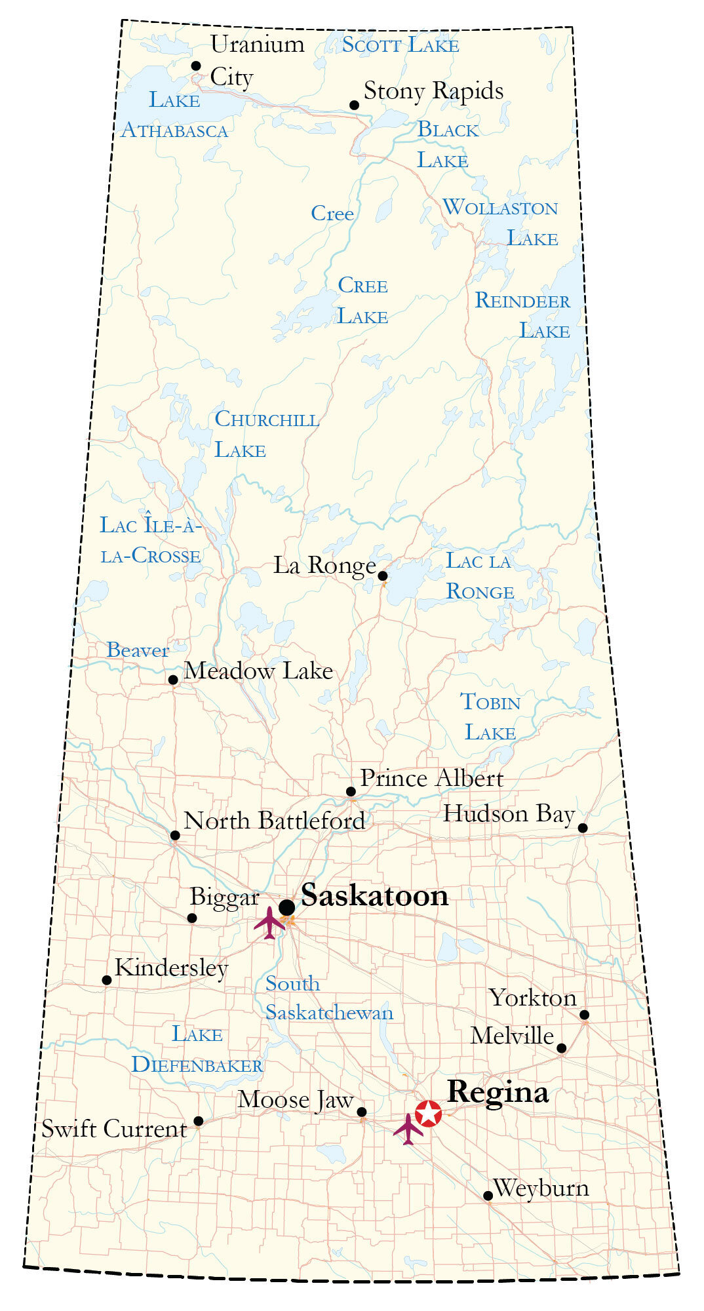
CLINICS BY REGION

Slide 14
PROFESSIONAL CONDUCT STATISTICS

Slide 15
PCC Summary
Calendar Year | Advertising | Clinical | Total | Dismissed | Actioned | Open
2023 | 9 | 55 | 64 | 13 | 16 | 35
2022 | 9 | 38 | 47 | 22 | 23 | 2
2021 | 27 | 37 | 64 | 30 | 34 | 0
Cases
Status

Slide 16
QUALITY ASSURANCE PROGRAMS

Slide 17
QUALITY ASSURANCE
Permits and Authorizations (CBCT, Neuromodulators, Sedation, Facility)
Continuing Education Requirements
Sterilization and Waterline Monitoring Program
Prescription Review Program and Pharmaceutical Information Program
Critical Incident Reporting
Attestations of Registrants
Continuing Competency Program (redevelopment)

Slide 18
RECENTLY AMENDED STANDARDS
28 Standards Total
Advanced Facial Esthetic Therapies and Adjunctive Considerations
CDSS Long Term Care Resident Guidelines
CDSS Sedation and General Anesthesia Standard
Continuing Education Policy
Infection Prevention & Control Standard
Criminal Record Check Policy
Radiation and Imaging Standard

Slide 19
RECOMMENDATIONS

Slide 20
RECOMMENDATIONS
Regulated Health Profession Act
CDCP Balance Billing
Access to Care
Hospital Dentistry Program
Saskatoon Community Dental Clinic
Long Term Care Program

Slide 21
THANK YOU

